Slide 1
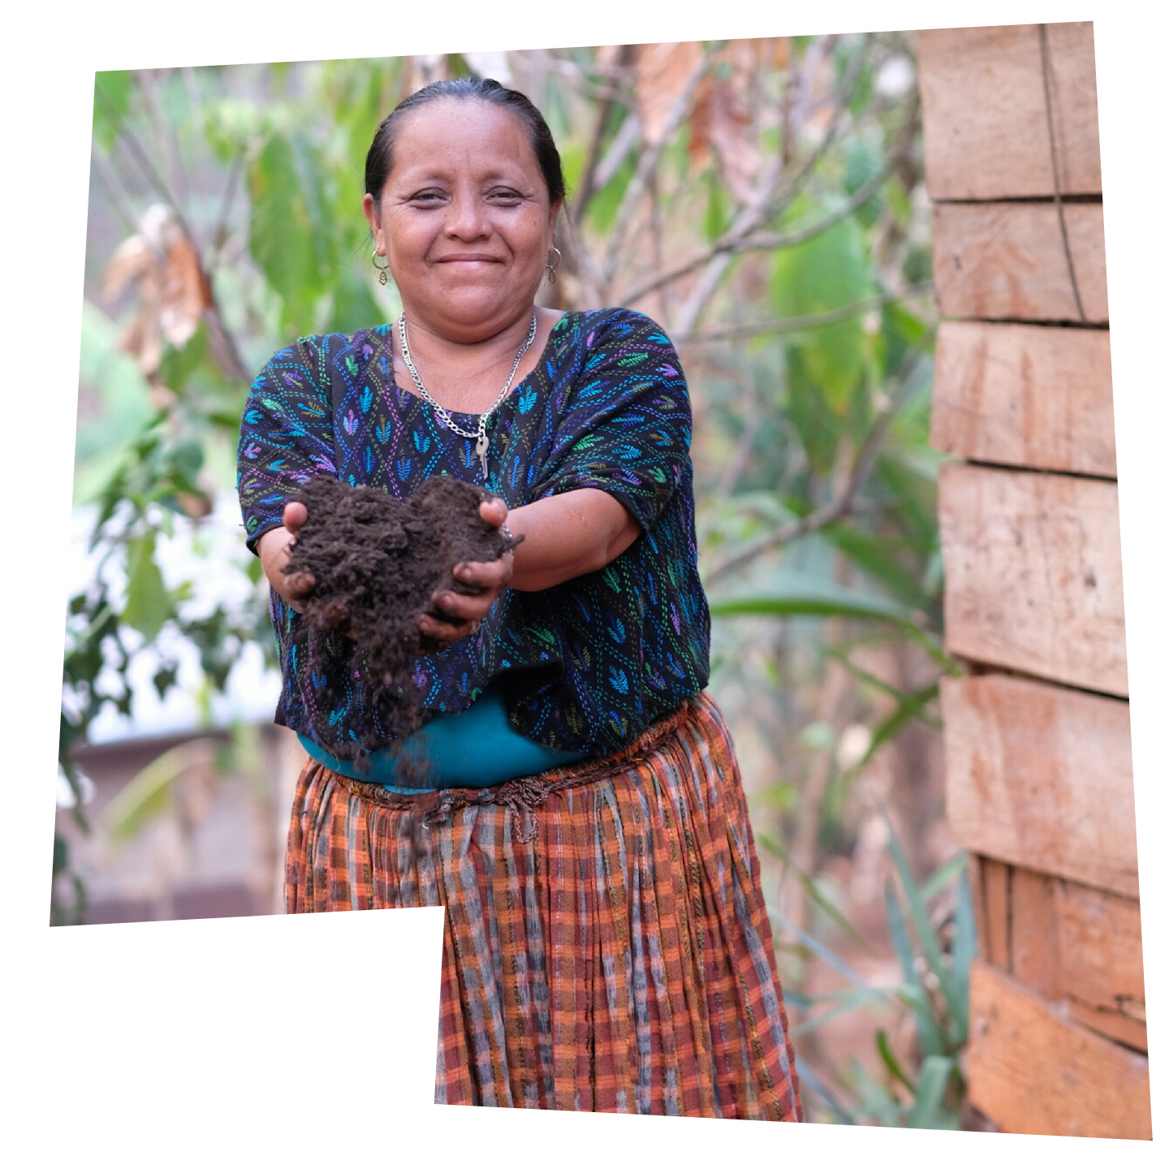
Christian Aid Week
All-age worship service
Notes:
There is a link to the song Let Justice Roll Like a River in this slide which could be played as people are arriving for the service and drawing around their hands and cutting them out.
Photo:
This is Aurelia, from Guatemala, who we’ll talk more about as we move through this presentation, and learn how she’s been supported by Christian Aid’s partner, Congcoop.

Slide 2
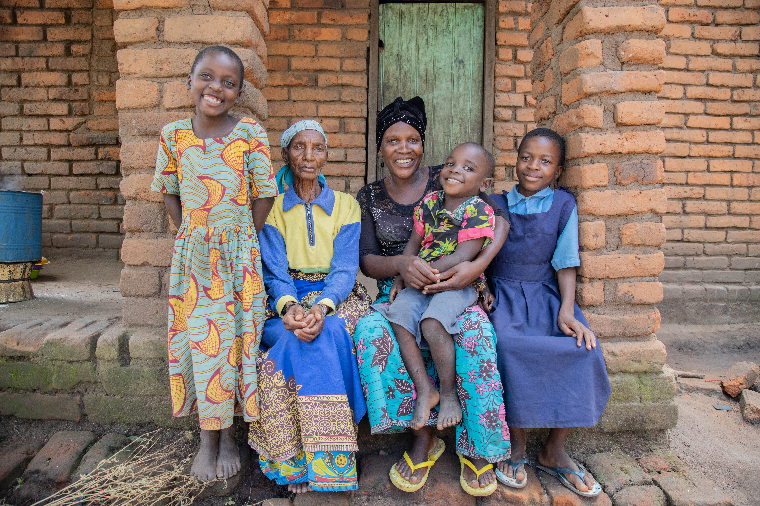
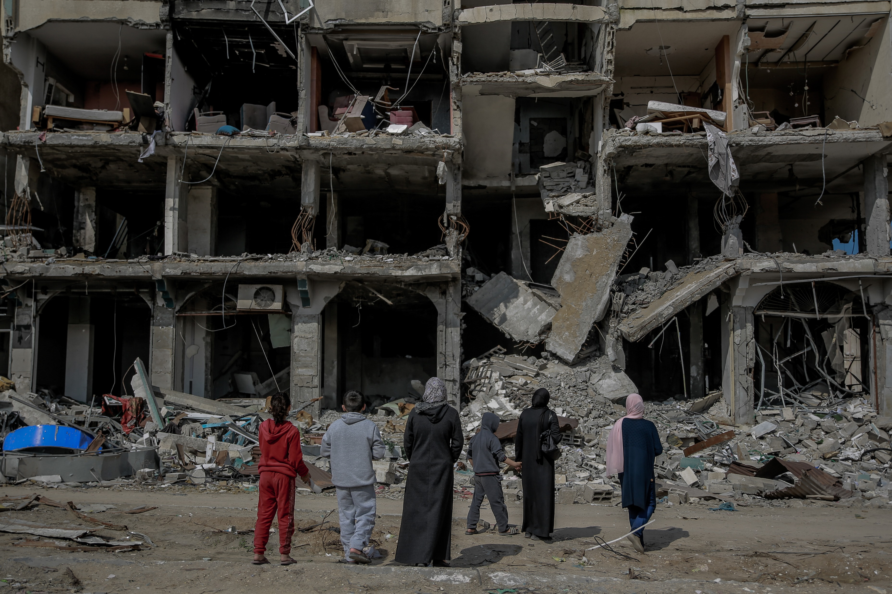
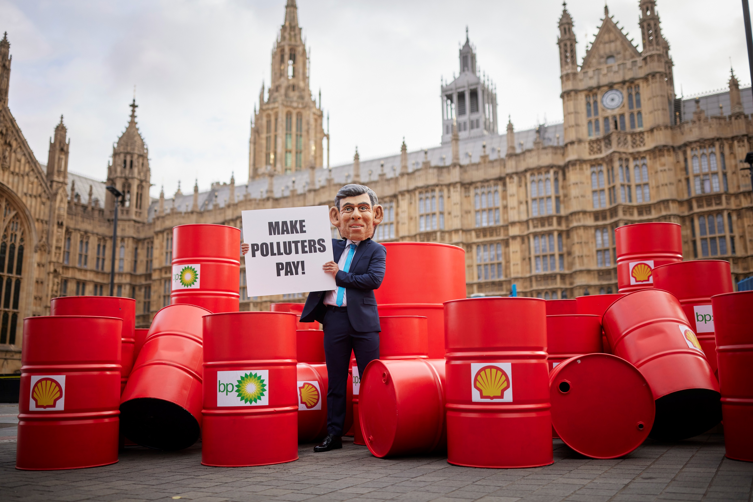
Through partners to support people to live full lives, free from poverty, such as Idah and family in Malawi.
Responding to emergencies and supporting people who have experienced climate disasters and war, such as in Gaza.
Calling on decision makers to make the world a fairer place for everyone.
Christian Aid works in three main ways:
Notes:
Christian Aid is a charity that works with communities to support them to live full lives, free from poverty.
Photos:
Top image: Idah with her family in Malawi.
Central image: A destroyed apartment block in Gaza City, February 2024.
Bottom image: Christian Aid takes part in a stunt outside the UK Parliament as part of the Make Polluters Pay action day in September 2023.

Slide 3
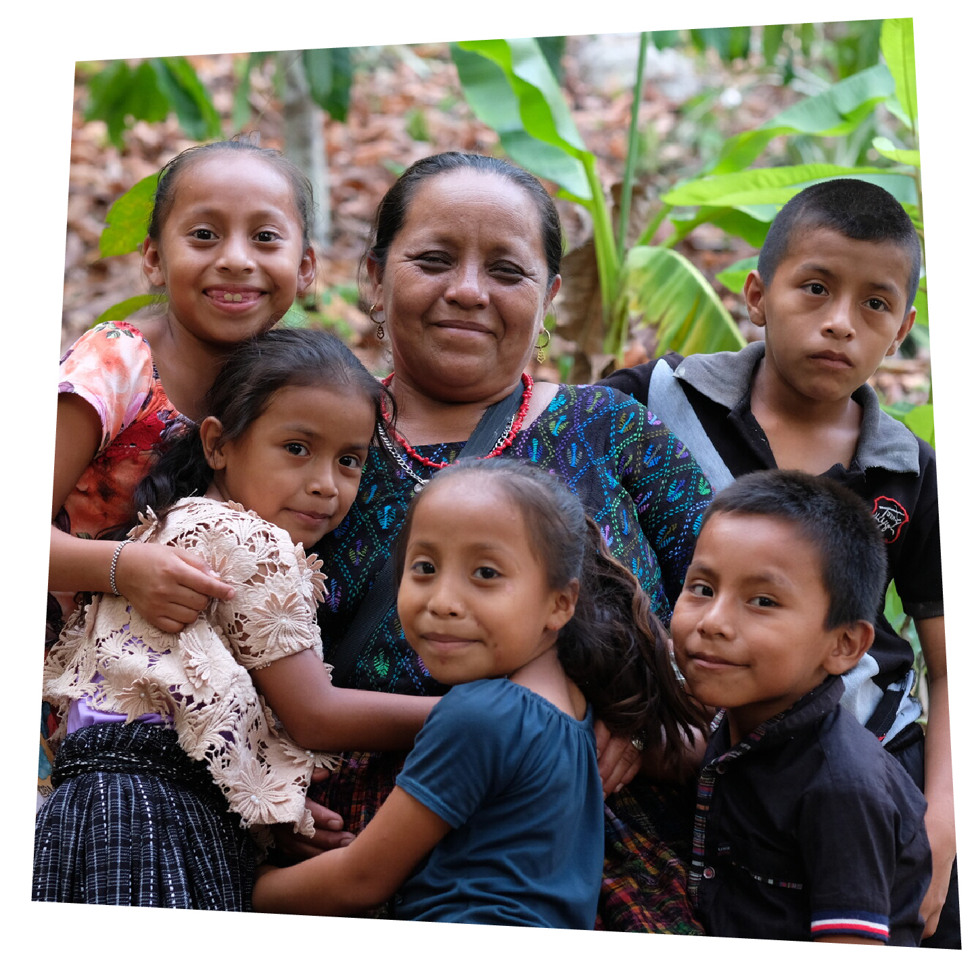
Aurelia with some of her grandchildren.
Notes:
We're going to learn about Aurelia today and how Christian Aid is supporting her as she makes life better for those she knows and loves. Aurelia lives in Guatemala and here is a photo of her with her grandchildren.
Photo:
Aurelia with some of her grandchildren.

Slide 4

Aurelia’s holding hope in her hands.
Notes:
We'll learn what an amazing person Aurelia is and how she takes things into her own hands, finding ways to make life better for her family and community.
We're going to be learning about how she's finding solutions as a result of gaining skills and tools, helping her to hold hope in her hands. We'll also find out what she's holding in her hands in this photo!
Photo:
This is Aurelia, from Guatemala, who we’ll talk more about as we move through this presentation.

Slide 5

Written on the Palms of
God’s Hands
Notes:
If you’d prefer, please change this to another song of your choosing.

Slide 6
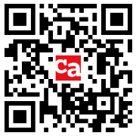
Christian Aid Week film
Please download and play this year's film, which can be
found at caweek.org/Resources or scan this QR code:
Notes:
Please download the film and link it to this slide. Please then delete the text and QR code from the slide so only the heading and film is seen.

Slide 7
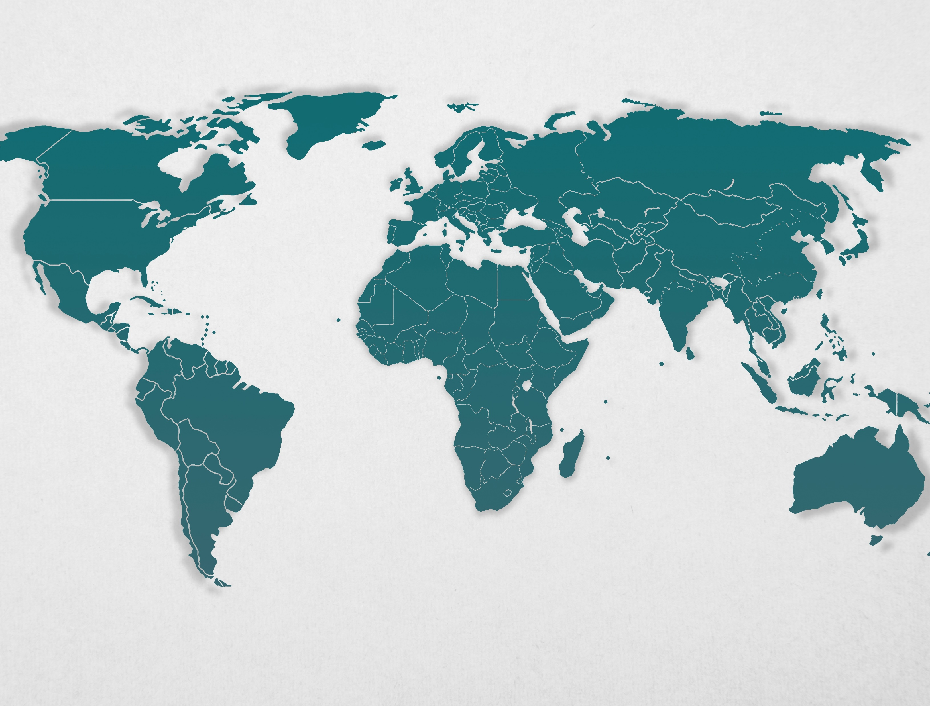


Guatemala

Slide 8
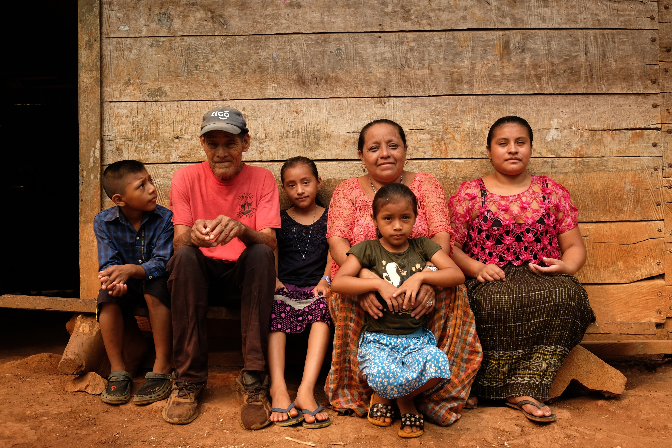
Aurelia with three of her grandchildren, her father, Ricardo, and her daughter-in-law.
Notes:
Photo:
Aurelia has eight grown-up children and lives with one of her sons and his wife. Aurelia’s many grandchildren visit her home every day.

Slide 9
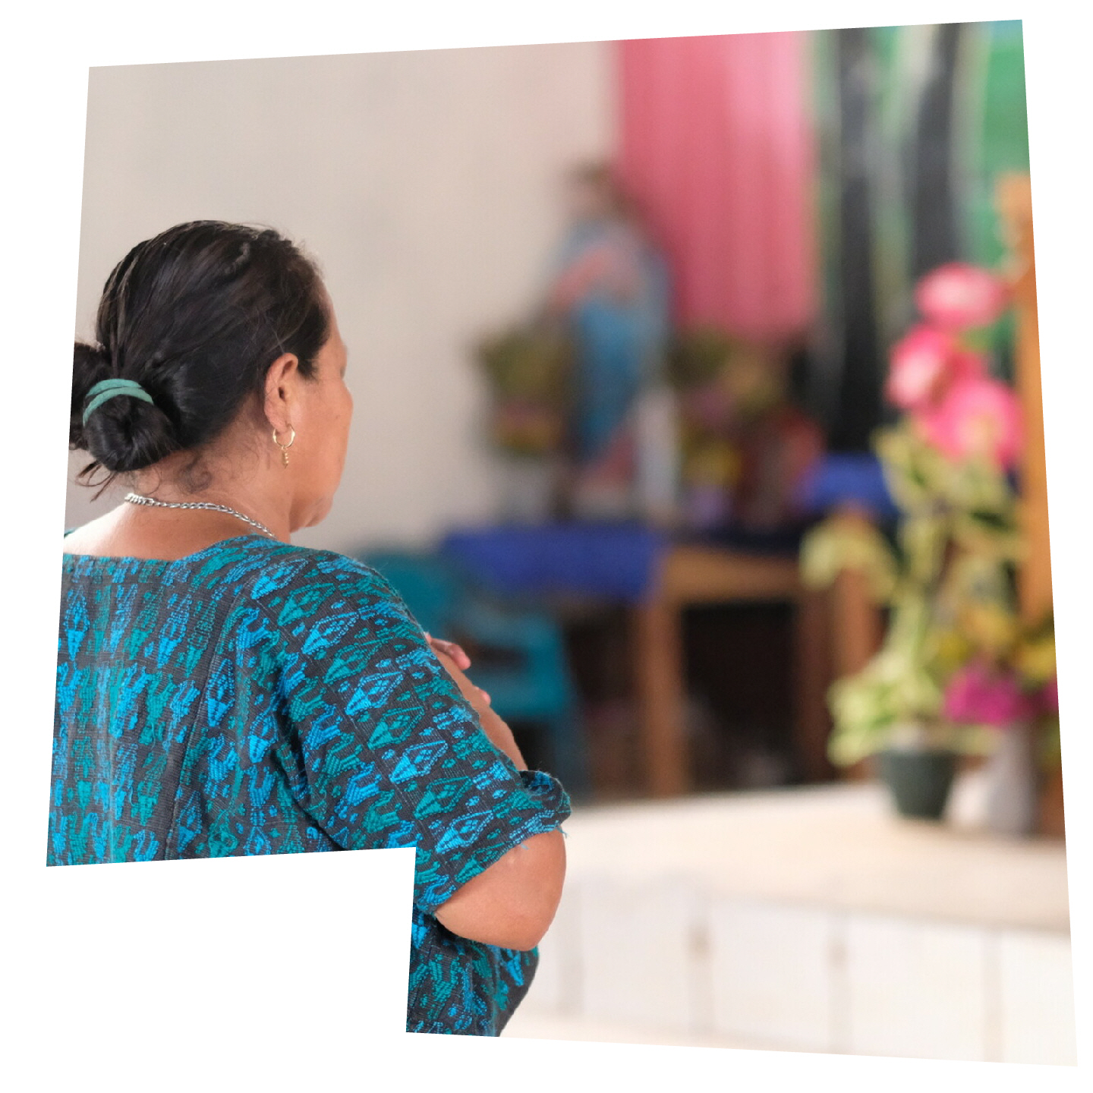
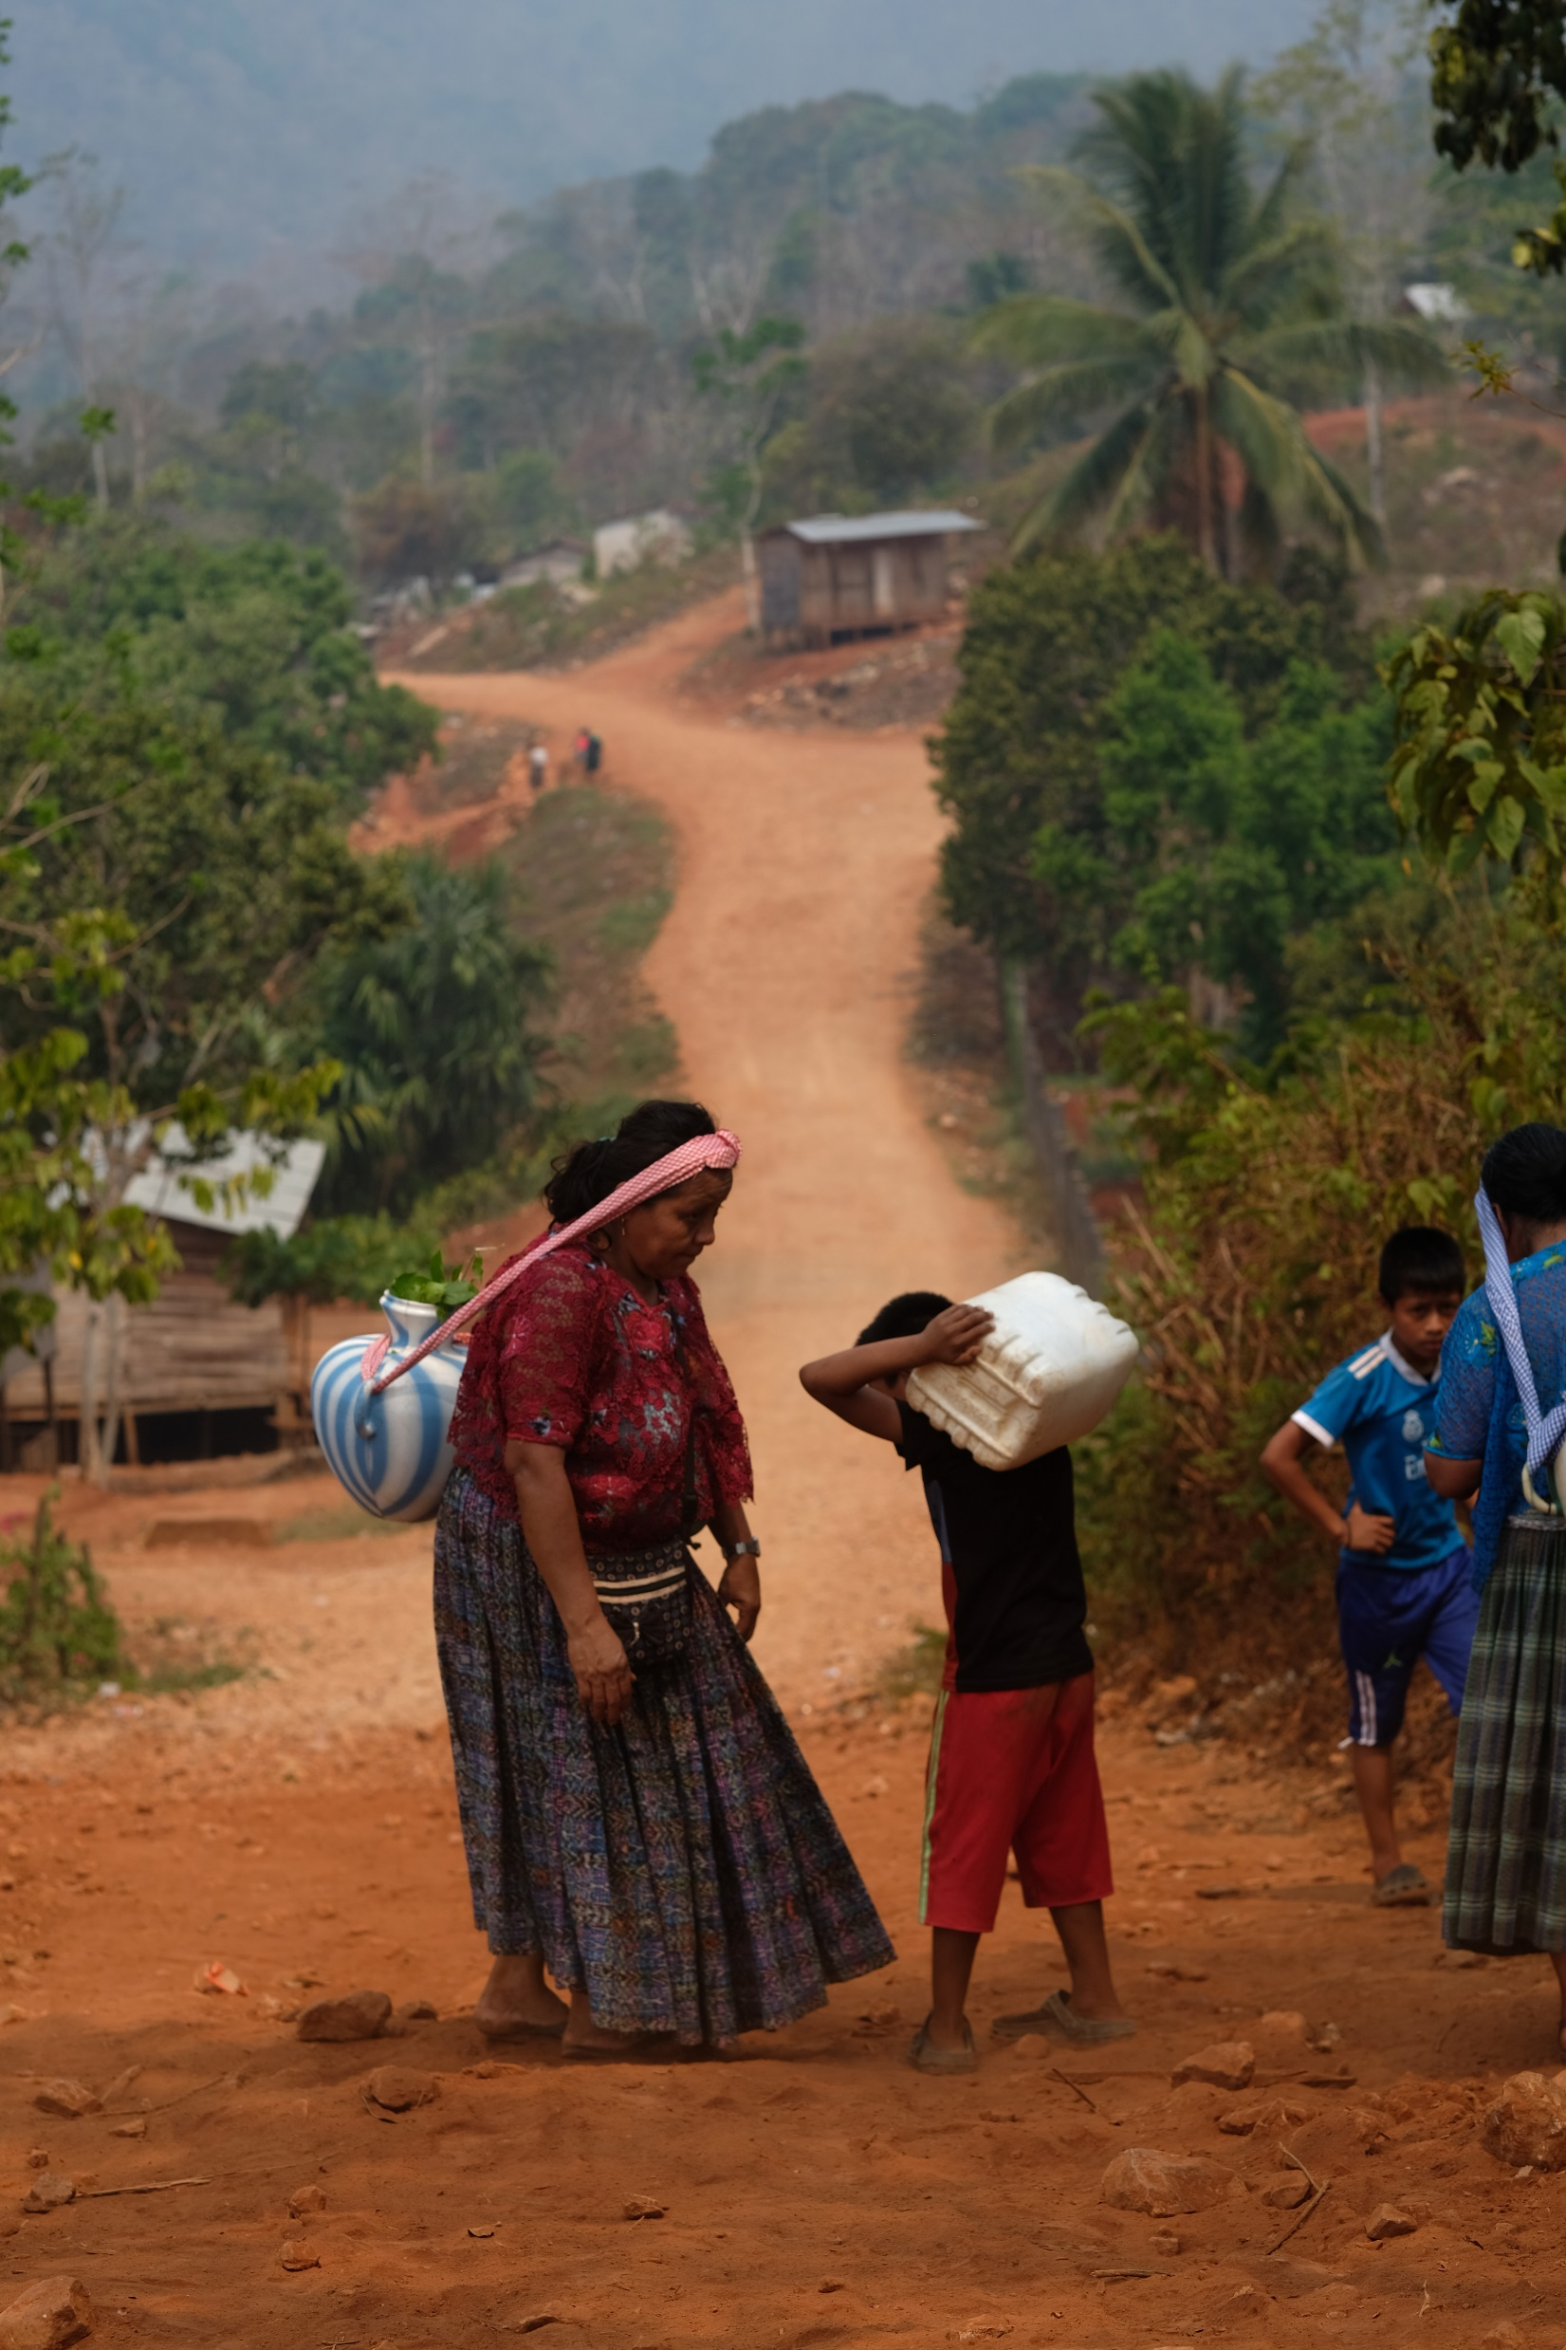
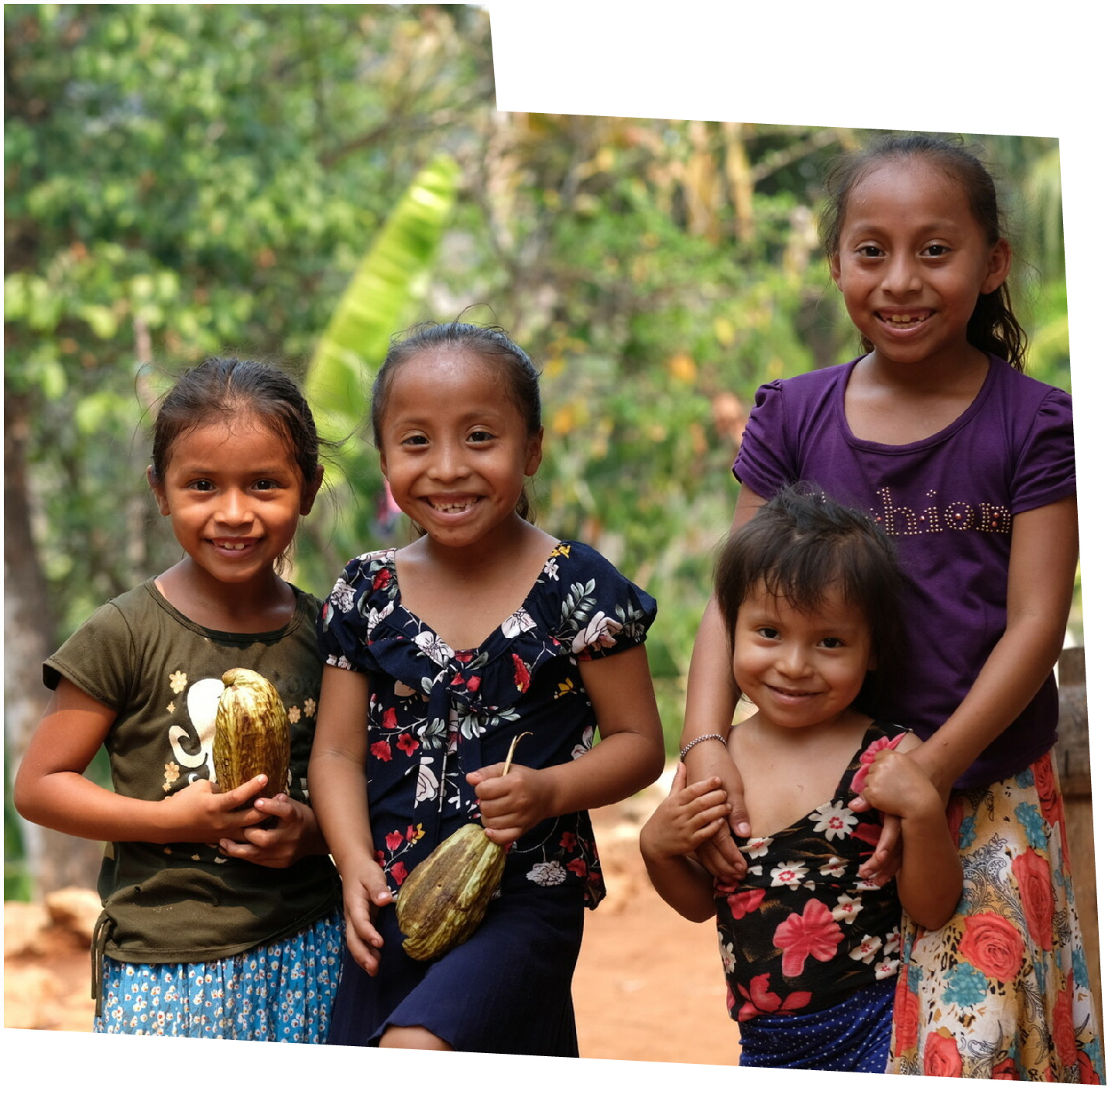
Notes:
Aurelia's family belongs to the Indigenous Q’eqchi’ (pronounced: Co-WAY-chee) community of the Alta Verapaz region in Guatemala. It’s a close and supportive rural community who live by a blend of Mayan and Catholic traditions, holding the natural world as precious and sacred.
Photos:
Left image: Some of Aurelia's grandchildren (left to right), Sheny, 9, Karla, 7, Dilia, 3, and Daily, 9.
Central image: Aurelia and grandson collecting water.
Right image: Aurelia praying in her church.

Slide 10
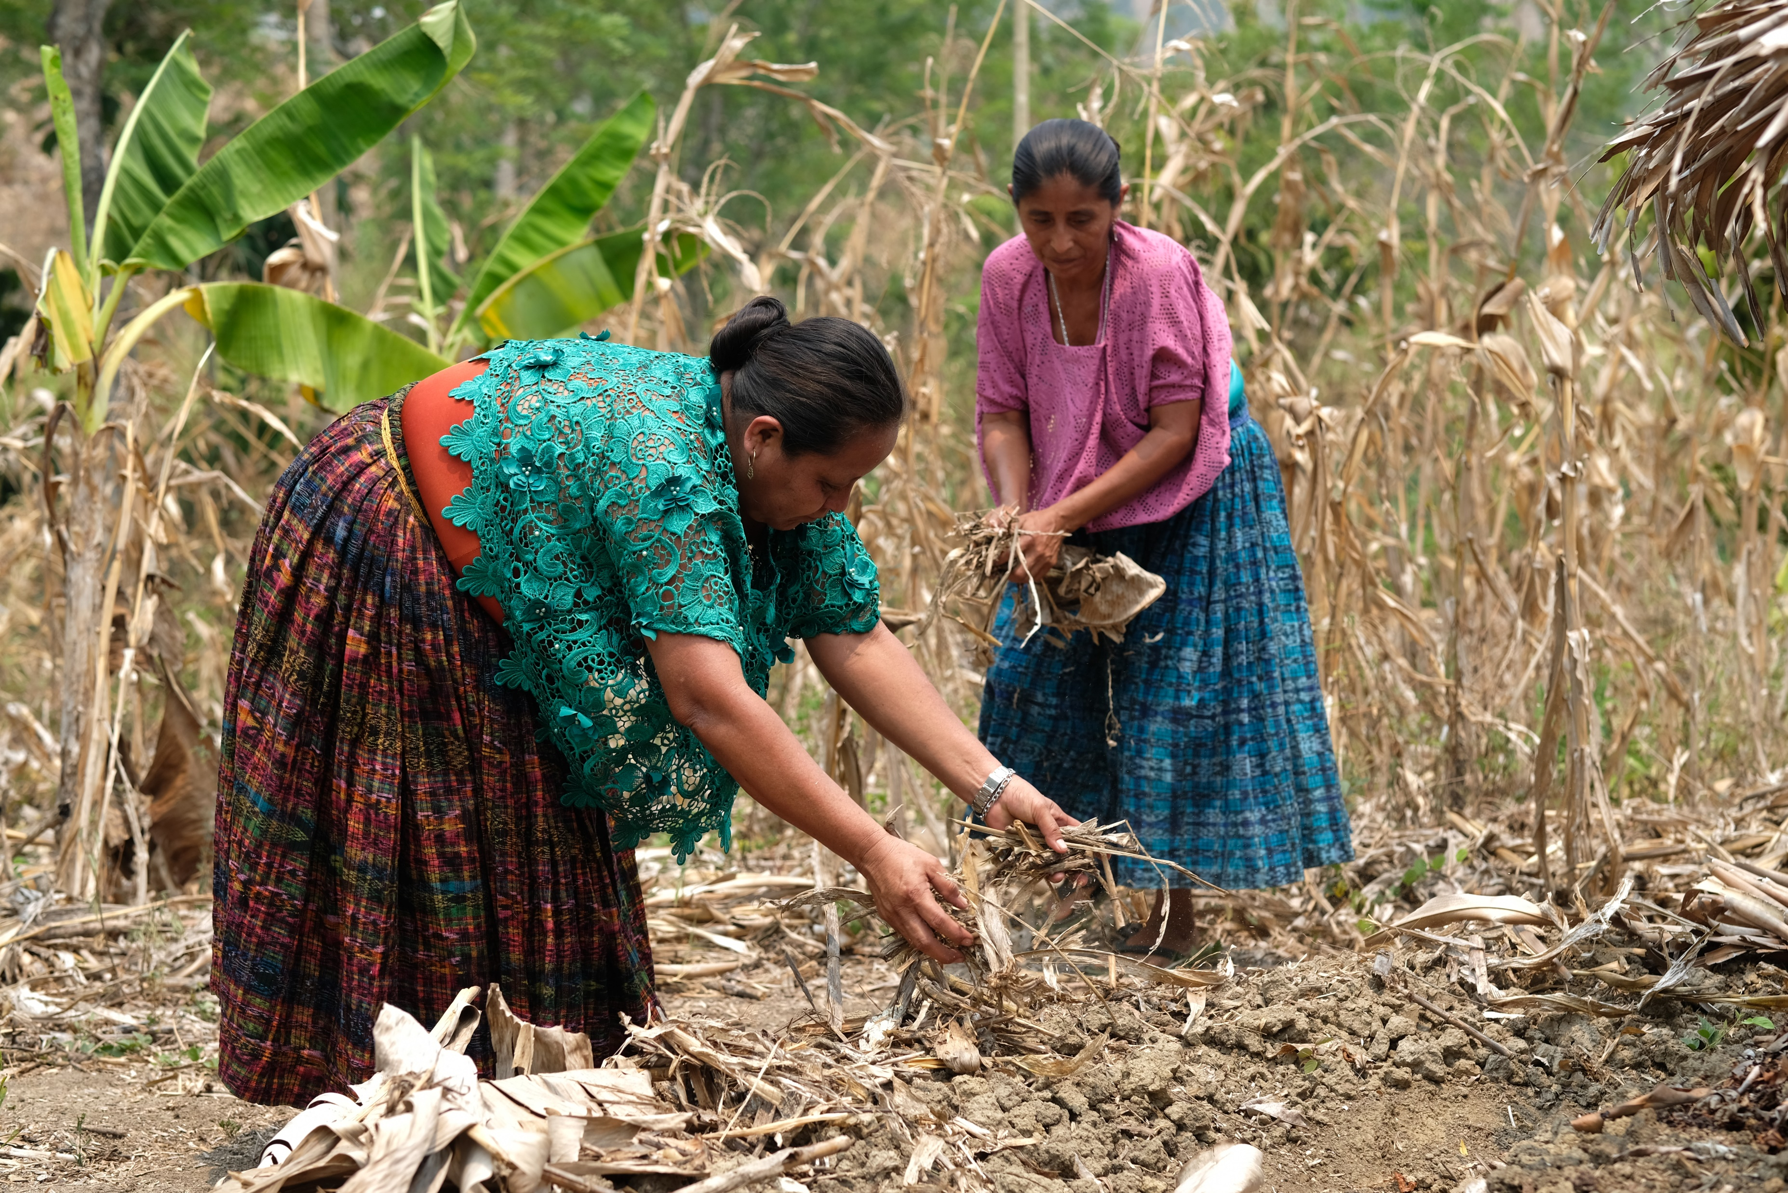
'Climate change has been killing our crops, and this is our food.'
Notes:
The climate crisis and industrial plantations have changed Q’eqchi’ land dramatically. Heatwaves, storms and unpredictable seasons are ravaging farms. Industrial agriculture is taking over the last of the region’s natural resources to feed the world’s richest countries. Many of the vital crops that Aurelia depends on are withering and dying before her eyes. It’s a heartbreaking injustice that a community should be threatened by a climate crisis they didn’t cause.
The quote is Aurelia’s.
Photo:
Aurelia and Sofia receiving agroecology training.

Slide 11
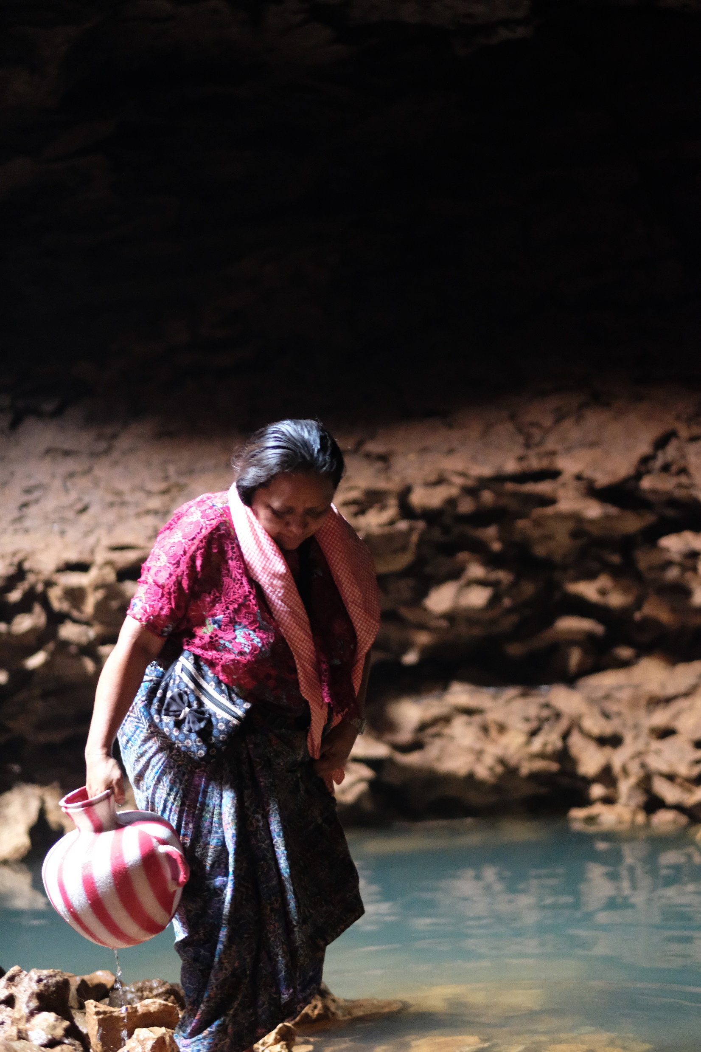
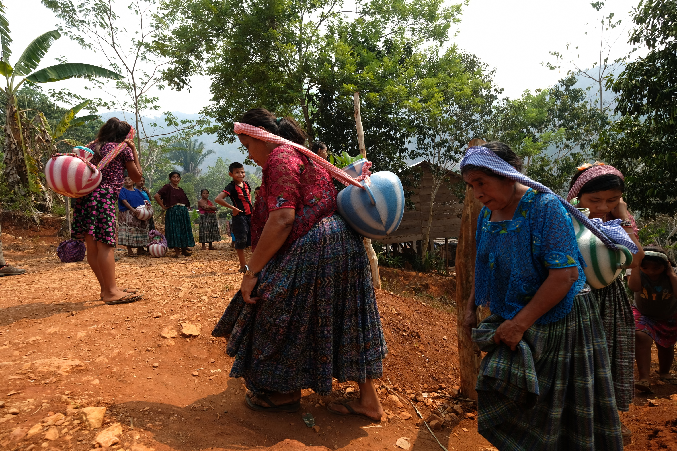
‘Our water resources are drying up. It means we can’t water the crops, and there is no food production.’
Notes:
Like the other women and girls in her community, Aurelia must go twice a day to collect water from a cenote – a natural sinkhole like a cave, with water at the bottom. Her walk takes around an hour each way. Part of it follows a steep, dark and slippery route that journeys in and out of the cenote.
In Aurelia’s lifetime, water sources could be found much closer to home, but both heatwaves and industrial plantations have drained them dry. Collecting water takes longer, which means the community has less time for other activities, such as selling produce, which allows them to then buy other things their families need. This pushes families further into the trap of poverty.
Photos:
Left image: Aurelia collecting water from the cenote.
Right image: Aurelia on her way to collect water from the cenote.

Slide 12
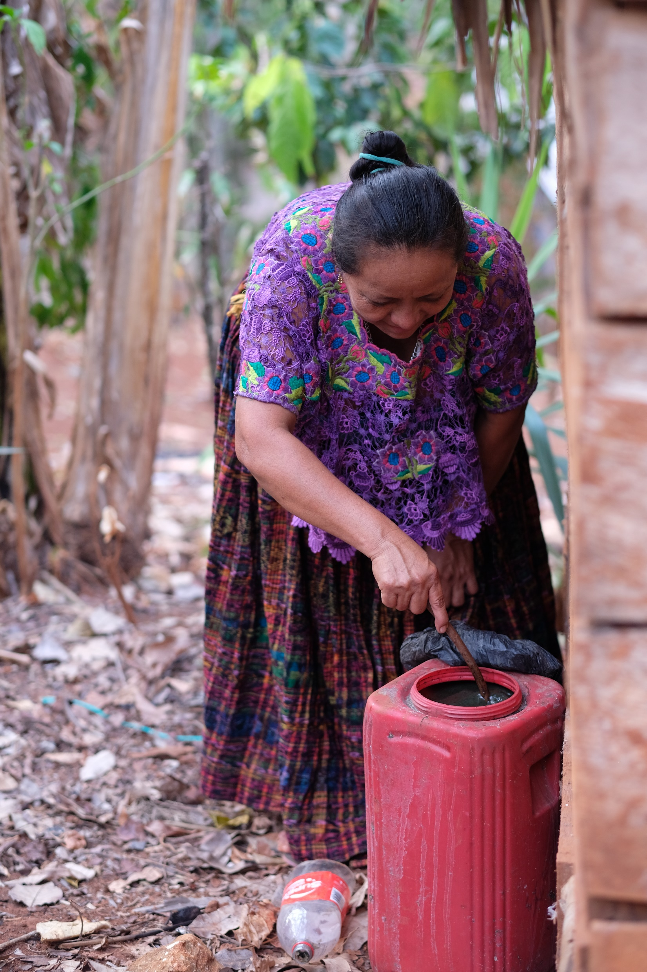
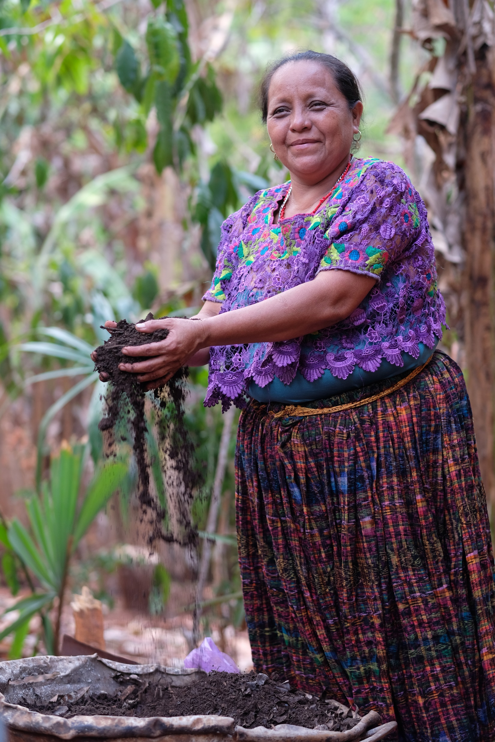
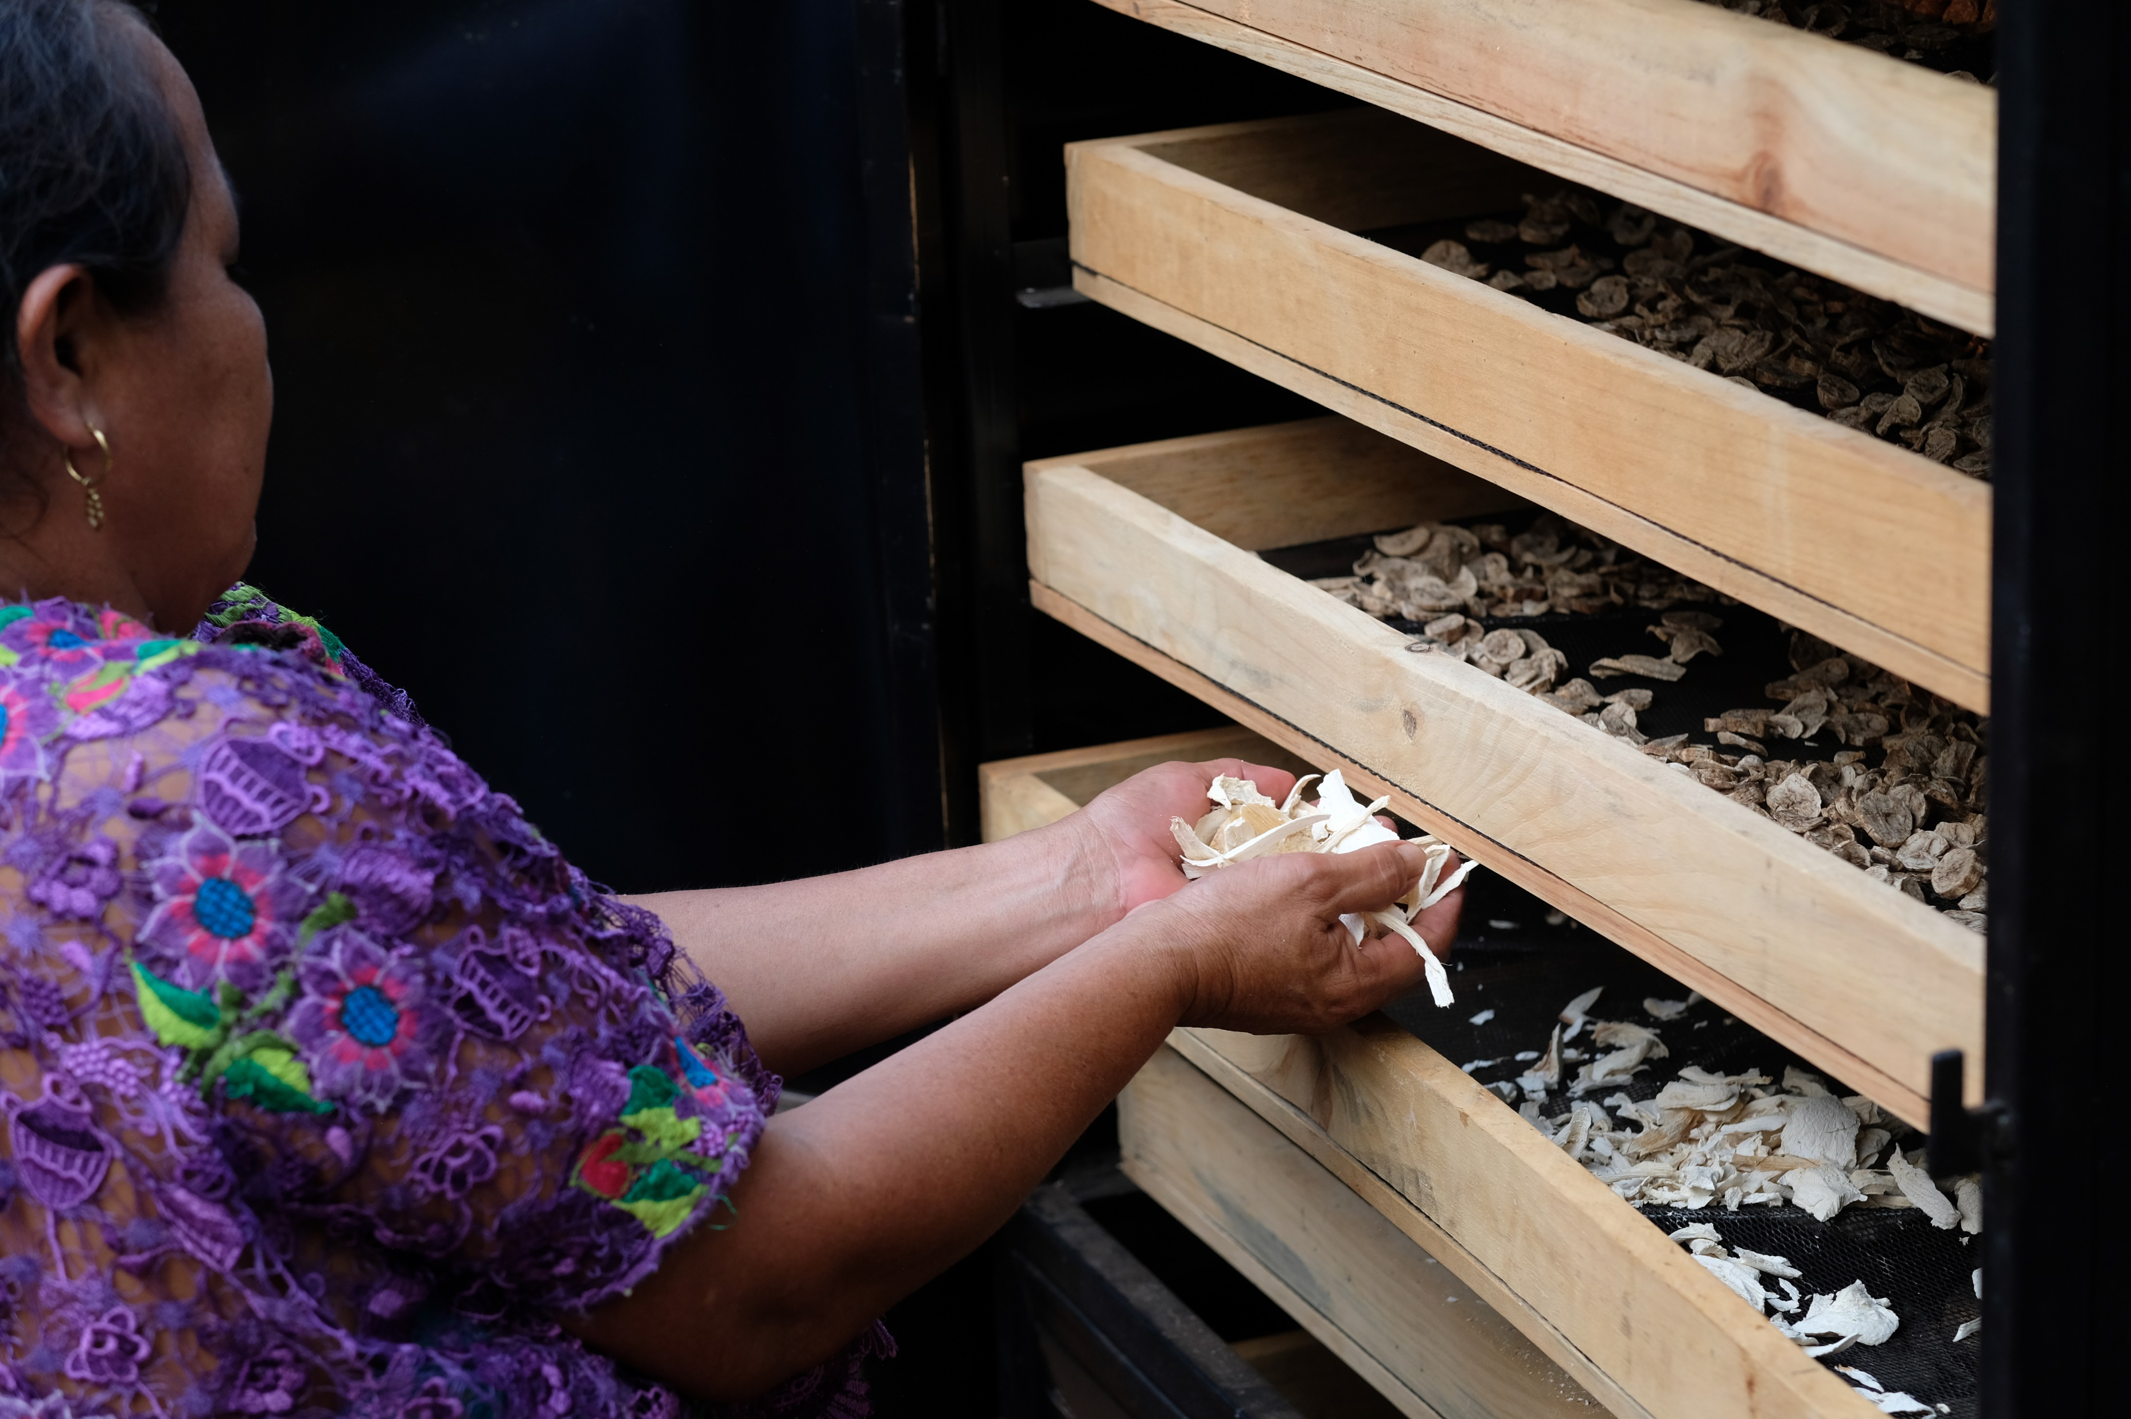
‘The most important thing I’ve got from Congcoop is knowledge, and you cannot put a price on knowledge.’
Notes:
Fortunately, Aurelia heard about an organisation that works in her area of Guatemala called Congcoop. They are partners of Christian Aid and train people like Aurelia in ways of farming that work with nature. By working with Congcoop, Aurelia has learnt skills and knowledge to grow native seeds that are better suited to the changing climate. She’s producing her own organic fertiliser, creating nurseries, constructing rainwater collection systems, and making nutritious food and medicine for her chickens. Congcoop also provided Aurelia with seeds and tools.
Photos:
Left image: Aurelia with organic liquid fertiliser after receiving training from our partner, Congcoop.
Central image: Aurelia with her dried plantains, ready to grind with cacao to make bread, to consume and sell. Our partner lends the dehydrators seen here to communities, to help with their income generation projects.
Right image: Aurelia with her fertiliser. Congcoop provided her with training on the benefits of organic fertiliser. She now encourages other women to follow suit.

Slide 13
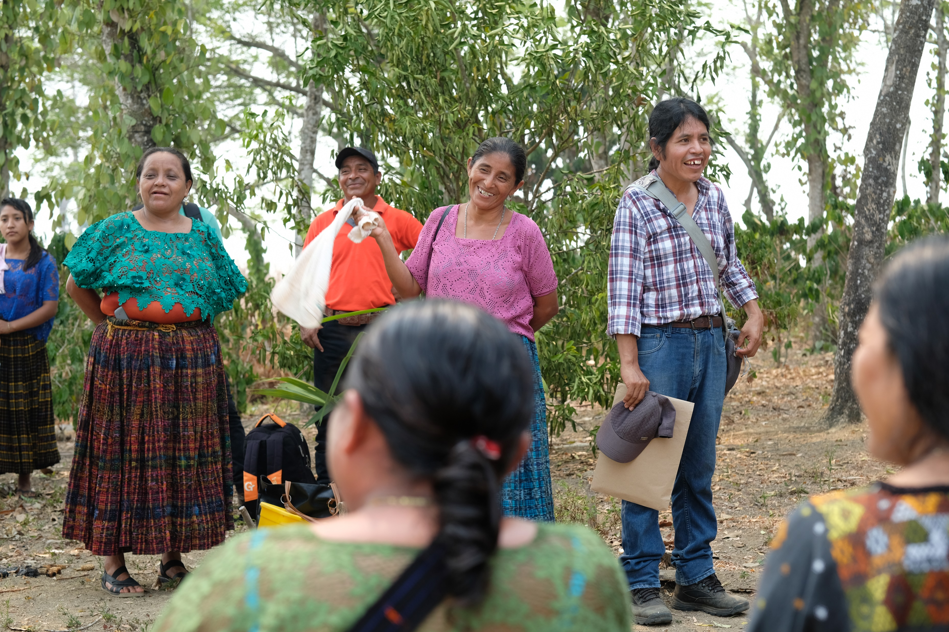
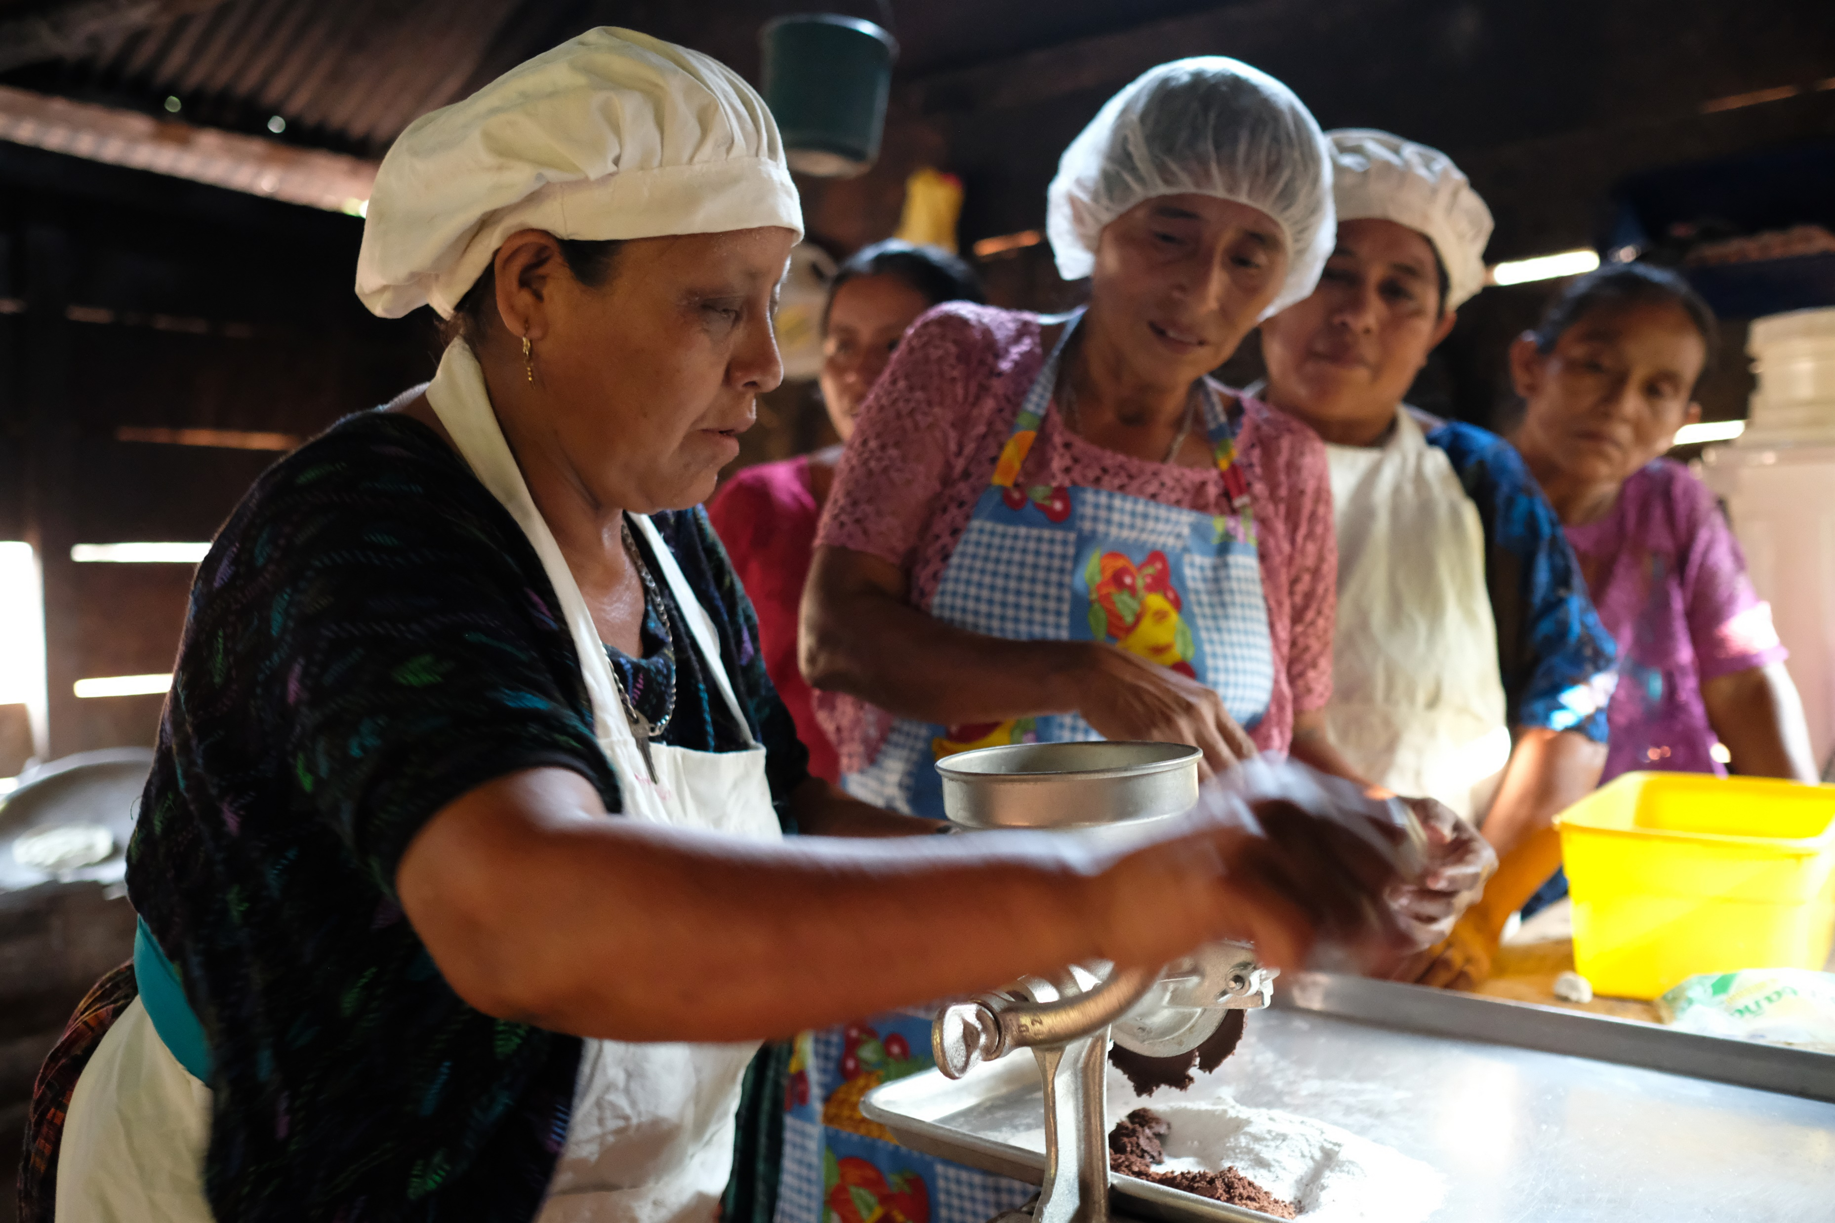
‘I really give my life to my neighbours, sharing my knowledge with them.’
Notes:
Aurelia can now grow cacao, sugarcane, cinnamon, corn and pineapples. She's restoring her ability to provide food for her family. Because she's now hopeful for the future, Aurelia has developed and leads other activities in her community, including producing chocolate, establishing a farmers’ market, and fighting for women’s rights.
Photos:
Top image: Aurelia attending agroecological training.
Lower image: Aurelia and Sofia grind cacao to make cacao and plantain bread. The grinder was provided by our partner Congcoop.

Slide 14
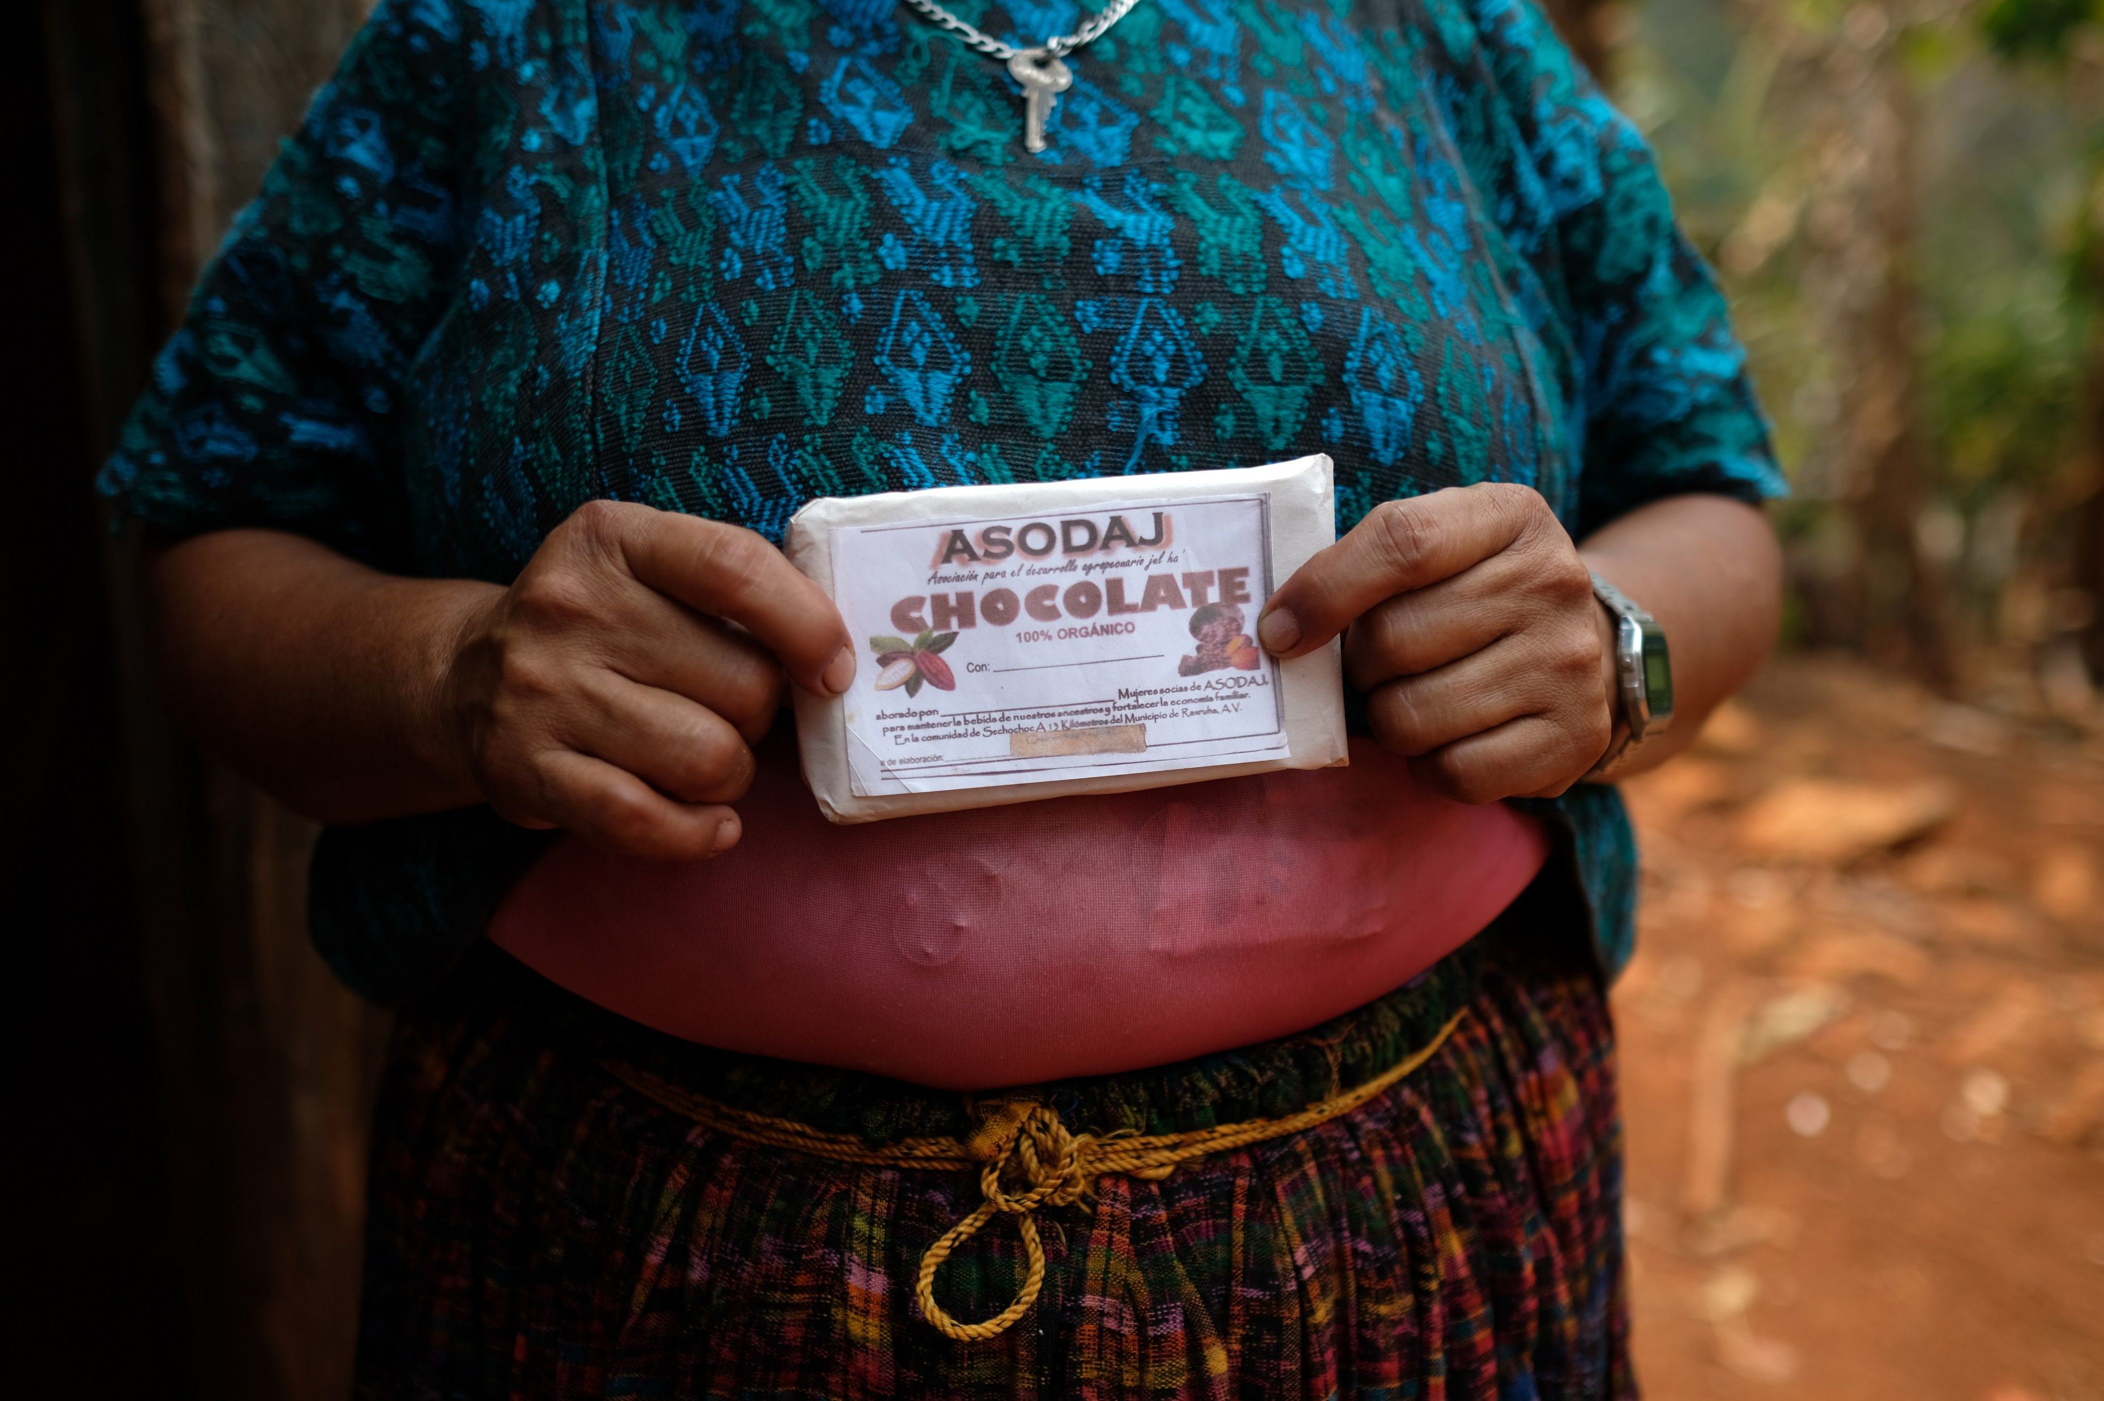
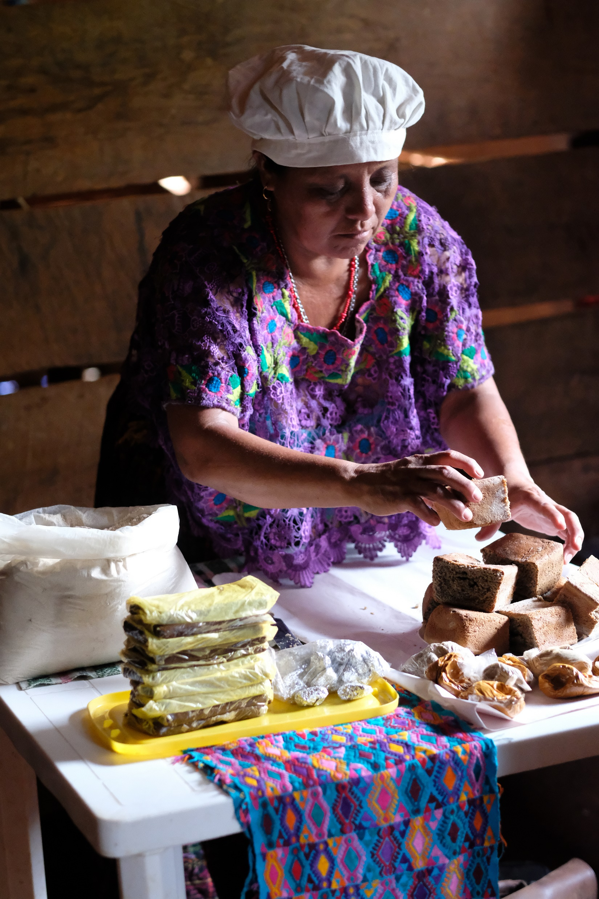
‘I feel very joyful and grateful when I'm preparing chocolate.’
‘I make cocoa products with all my heart! Perhaps that’s why they have such a good flavour!’
Notes:
With the support from Congcoop, Aurelia has learnt how to make chocolate and to sell it at a good price. With her profits, Aurelia can buy household essentials like soap and salt, and support her young grandchildren to stay in school.
Photos:
Left image: Aurelia with the cacao and plantain bread she consumes and sells for extra income.
Right image: Aurelia with a chocolate bar from her cacao business.

Slide 15
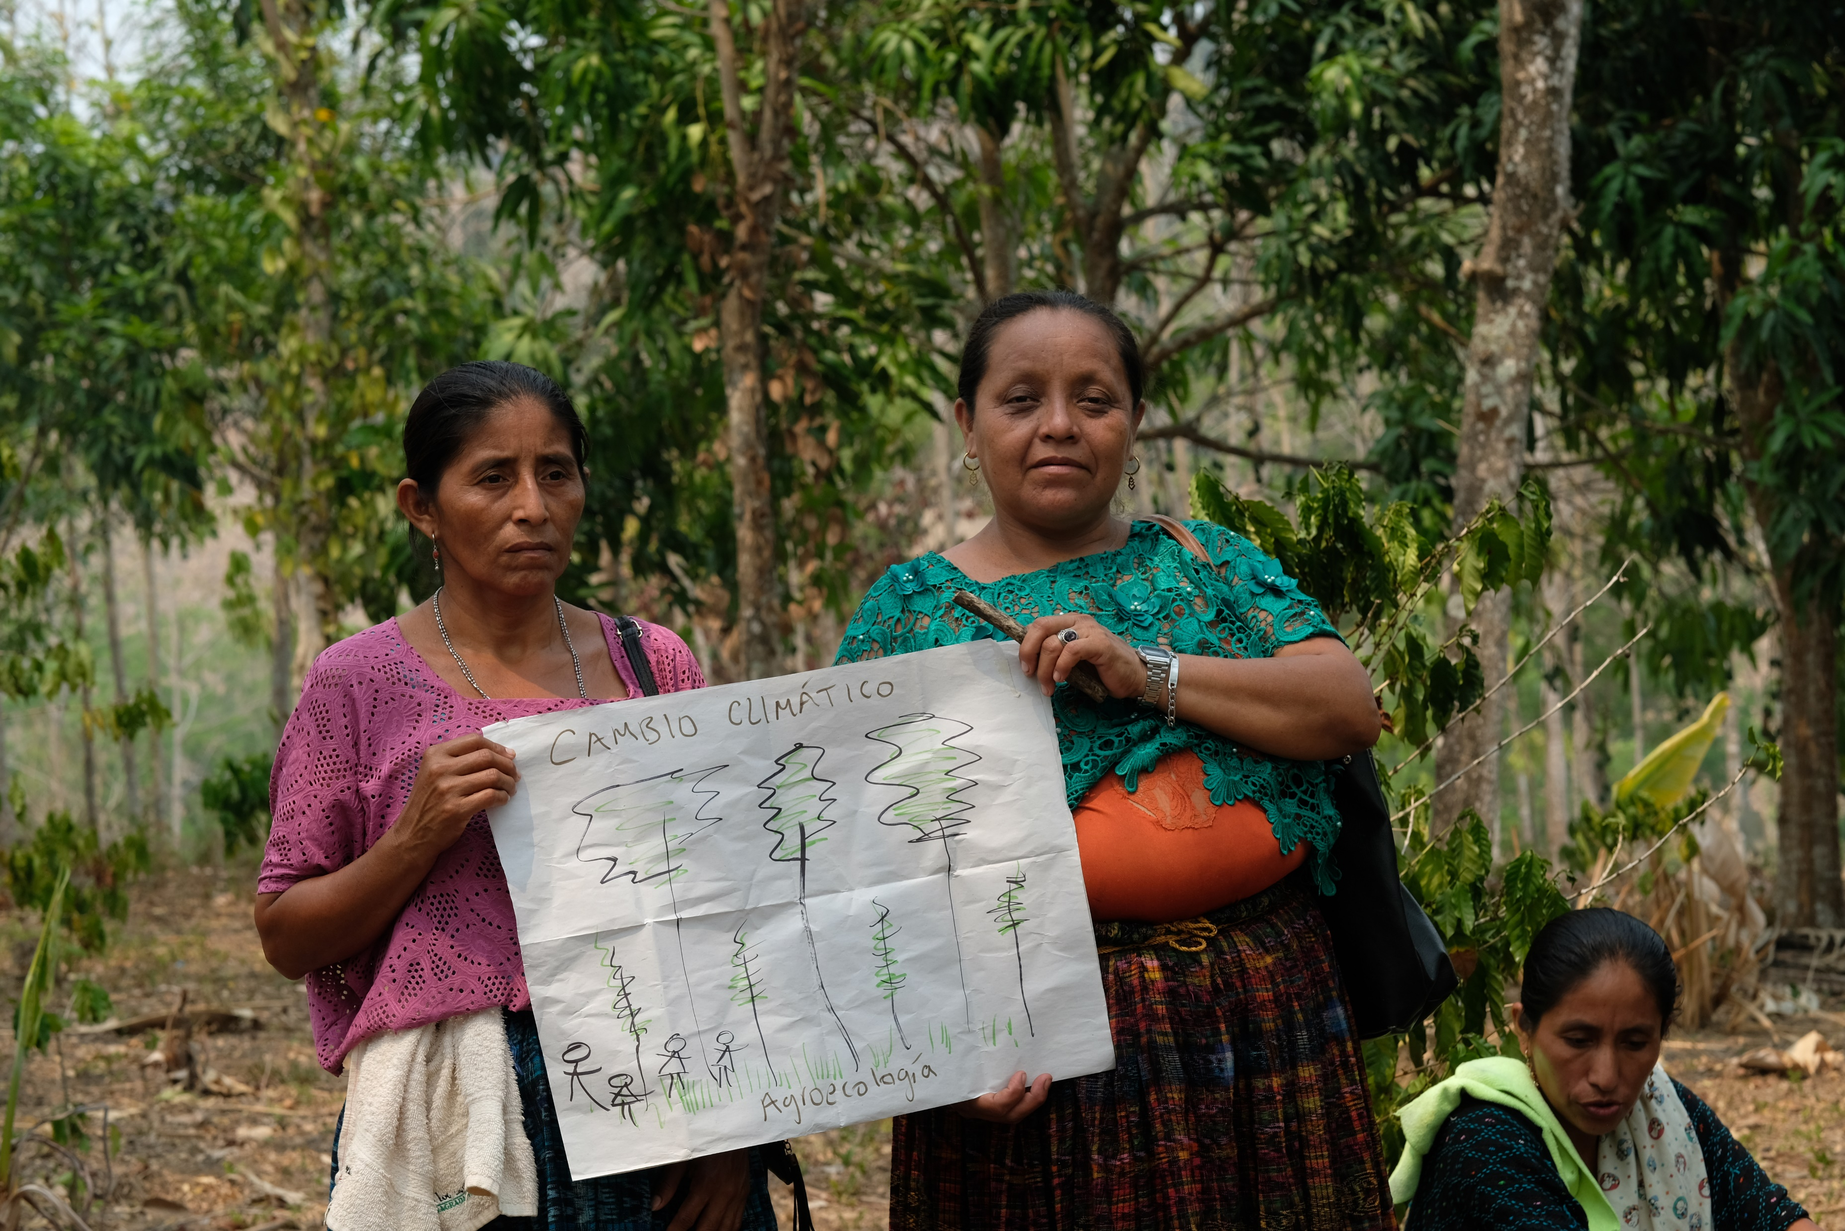
Notes:
Aurelia is a celebrated leader who holds the hopes of her community in her hands. Whatever she learns with Congcoop, she shares. As Aurelia trains other women in climate resilient farming, they too can adapt their practices and protect their families.
Photo:
An agroecological training demo with Aurelia and Sofia.

Slide 16
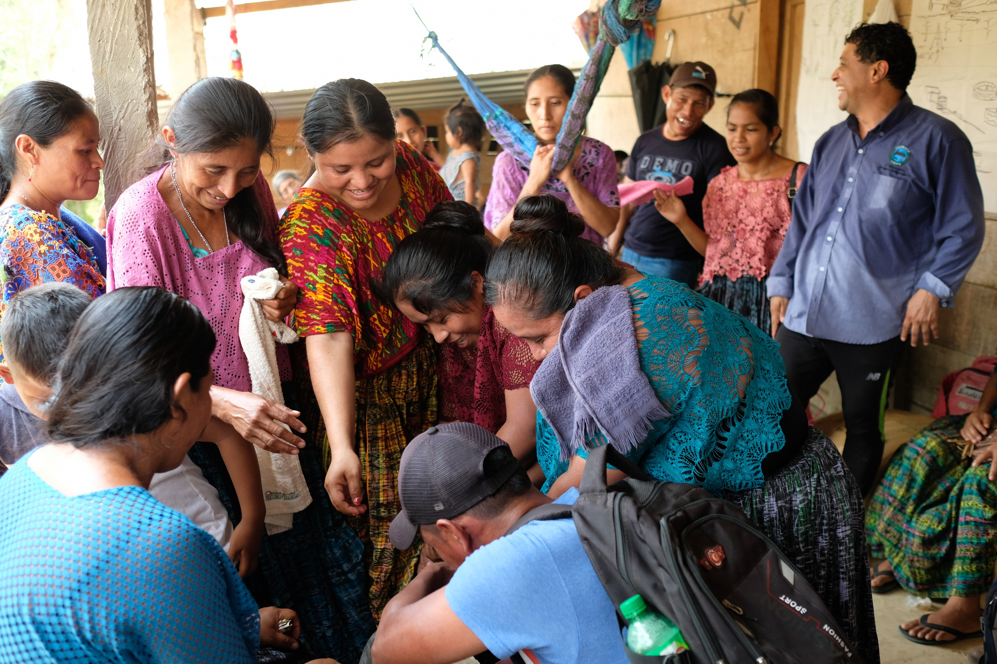
‘We’ve been courageous enough to not sell our land, and to work it to produce whatever we can. There are a lot of threats to sell, but our efforts as a community have kept us unified.’
Notes:
Aurelia also supports Congcoop to address the pressure that Indigenous farmers feel to sell their land to developers. Congcoop discourages land sales and supports communities to make their land work for them, so they don’t feel that selling is their only option. Aurelia is supported by Congcoop, which is supported by Christian Aid, which in turn is supported by churches like this one. Together we can bring hope.
Aurelia has hope for the future because of her own determination, alongside the new skills and knowledge she has gained. She is being a source of hope for her community and changing lives for the better.
Explain that there is now some time for everyone to do a couple (or more) activities that will help them think a bit more about hope and hands.
(You may want to have a song of your choice here before doing the activities.)
Photo:
Aurelia and her community work and learn together.

Slide 17
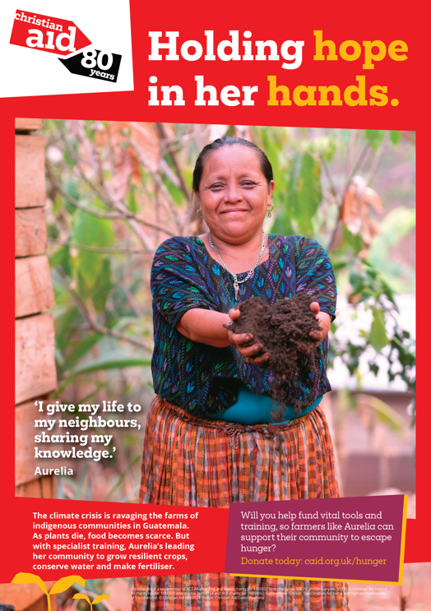

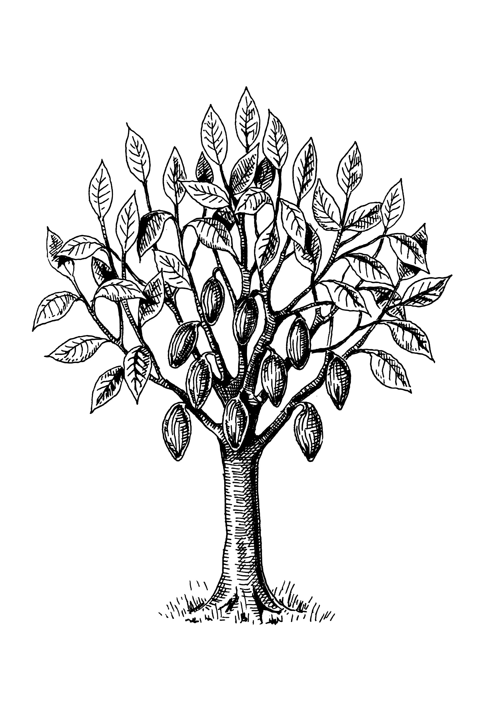
Activities
Notes:
Activity stations around church (allow enough time for each person to do at least 2 of the following activities):
Aurelia’s poster image (appendix 3).
Pairs of hands matching activity (appendix 4).
Write prayers on fingers on the cut-out hands to add to a prayer tree (appendix 5, cocoa tree).
Team competition using hands together – choose one of the following:
How many clothes pegs can you hold from a washing line?
As a team, make as tall a tree as possible out of newspapers/scrap materials or have a tower building competition using cardboard boxes or toy bricks...
Does having more than one pair of hands give you more hope of winning?
Cocoa tree: Shutterstock 645535003

Slide 18
Notes:
Draw together the powerful imagery of hands: God holds us in his hands (Ps 37:24, Jn 10:28); we are God’s hands and feet (Mt 25:40); and Aurelia holding hope in her hands because of all the actions she and her community are taking (Romans 15.13, 1 Peter 4:10). Ask the congregation: so, what does it mean that Aurelia is holding hope in her hands?

Slide 19


Slide 20
Please download and play ‘Let Justice Roll Like a River’, which can be
found at https://youtu.be/MX90qJBLT98
Notes:
Sing Let Justice Roll Like a River (listen for the words ‘the solutions are in our hands’).
Please embed this video into this slide by following the instructions below.
Click on the link below or on the slide to download the video to your files,
Back in PowerPoint, click on the insert menu and then the video icon,
Select ‘the device’ and then select the video from your folders and simply press insert.
If you don’t have an account to enable the video to be downloaded, select ‘online video’ and paste in the link below. However, for this option you will need to be connected to the internet when presenting these slides.
Save the presentation to your device.
Link:
https://youtu.be/MX90qJBLT98

Slide 21


Notes:
As you leave the service today you'll be able to give towards the work of Christian Aid as it supports people like Aurelia. Giving can be a sign of hope – being generous and investing in the future. Please advise that you can take contactless donations. Christian Aid has an app that can be uploaded to your phone to take donations.

Slide 22
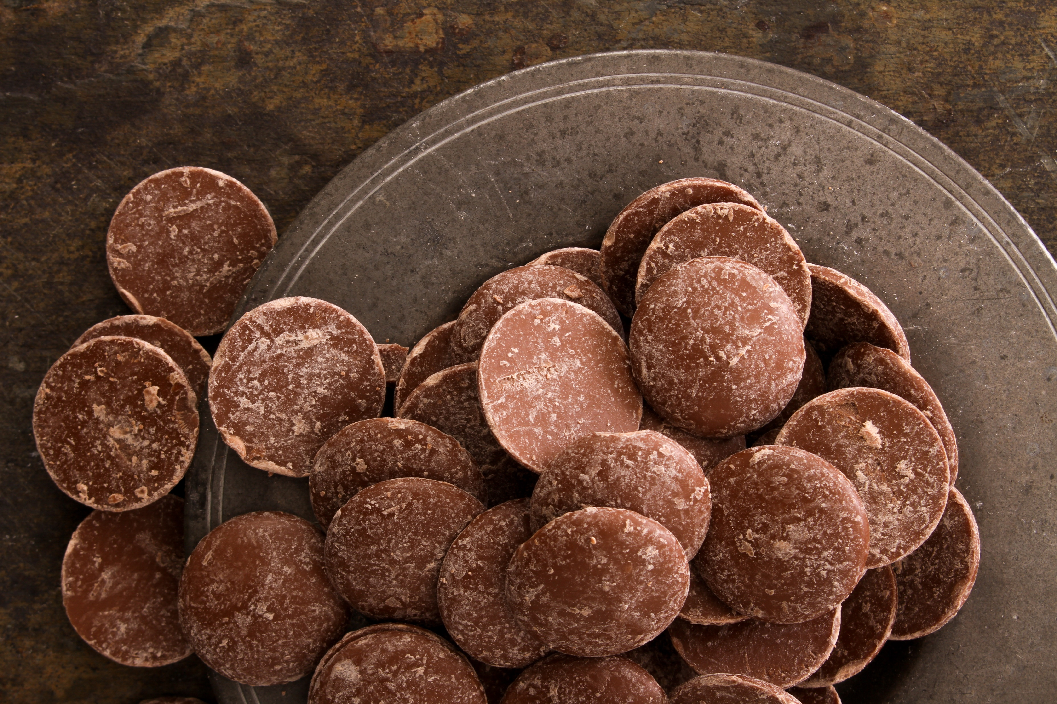
Notes:
Give everyone a chocolate button (or dairy free alternative if needed) with the instruction to not eat it immediately! Remind people that one of the solutions for Aurelia was to grow cocoa and make chocolate. So, to finish with, in a moment of silence, ask the congregation to put the chocolate button in their mouths. Let the chocolate button melt slowly, allowing the delicious taste to seep into their bodies as a reminder of how God wants to fill us with love and hope. As it melts, we can think about where hope is needed in the world and how we, along with Christian Aid, can support others to find hope.
Shutterstock 1149665423

Slide 23
Notes:
Christian Aid Prayer. Please refer to the prayer sheet available to download at caweek.org/Resources, to choose your prayer.

Slide 24
May you Find Peace
Notes:
Sing a song of blessing such as May you Find Peace (Fischy Music) which uses hands to emphasise the words and to send each other out into the coming week. Or sing The Blessing song to each other eg THE BLESSING [KIDS] - featuring kids from different nations #theblessing #christian #kidsworship or The UK Blessing — Churches sing 'The Blessing' over the UK.

Slide 25
Unless otherwise stated, all photographs in the presentation are credited to Christian Aid/Amy Sheppey

