Slide 1
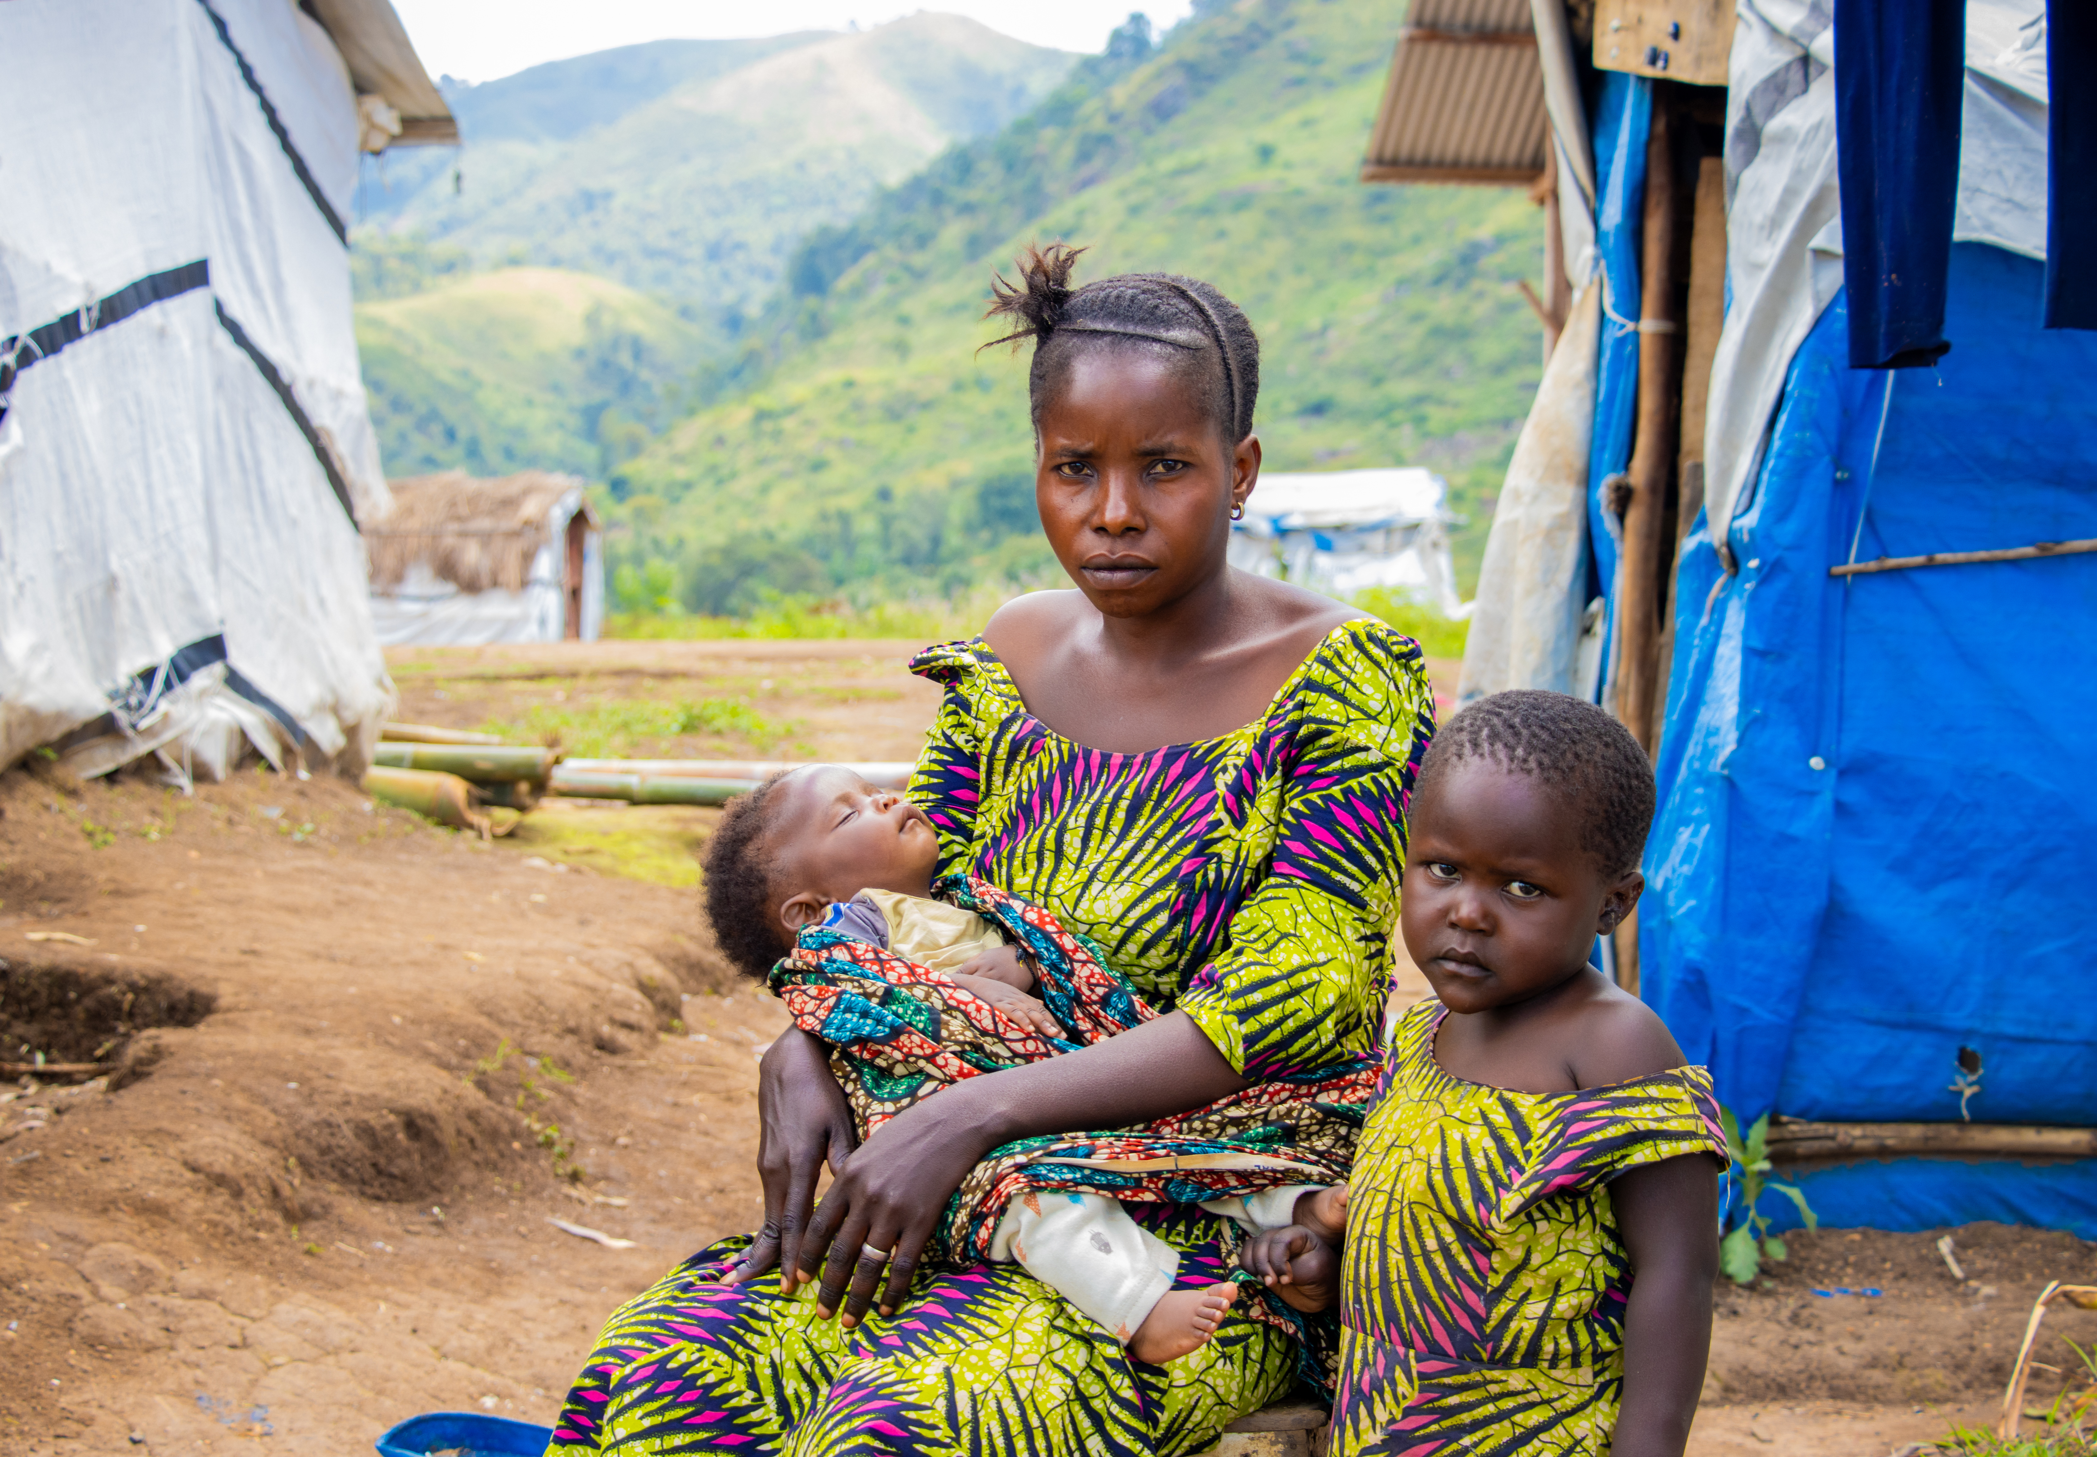
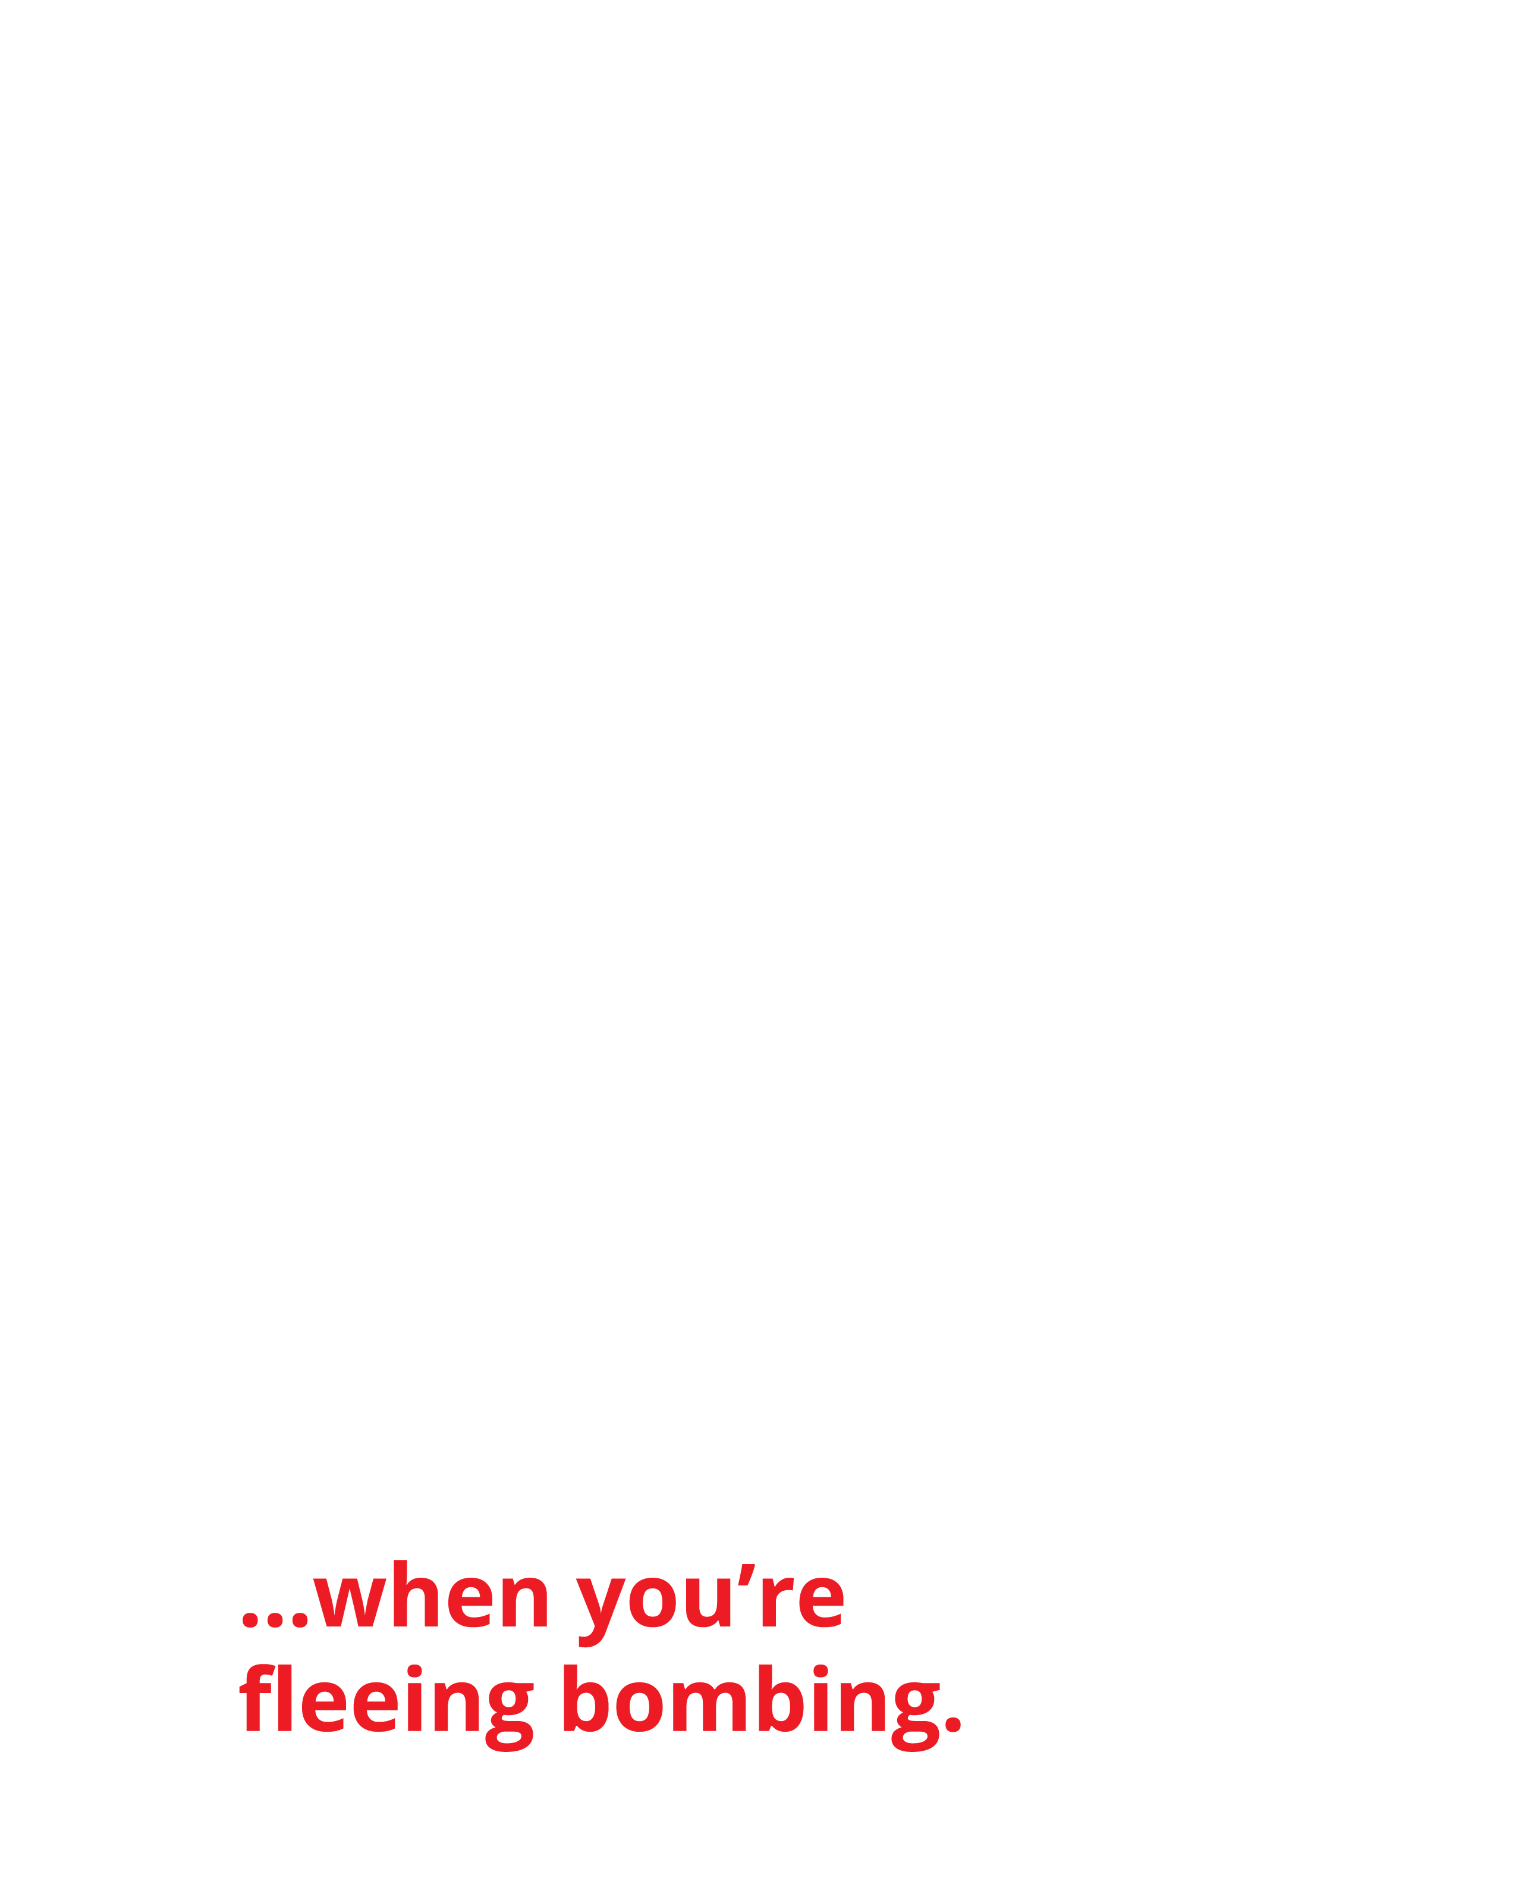
Chance with her baby, Siborge, and her son, Pacifique, outside their temporary shelter in Katashola Camp.
‘And she gave birth to her firstborn son and wrapped him in bands of cloth and laid him in a manger, because there was no place in the guest room.’
(Luke 2:7)

Slide 2
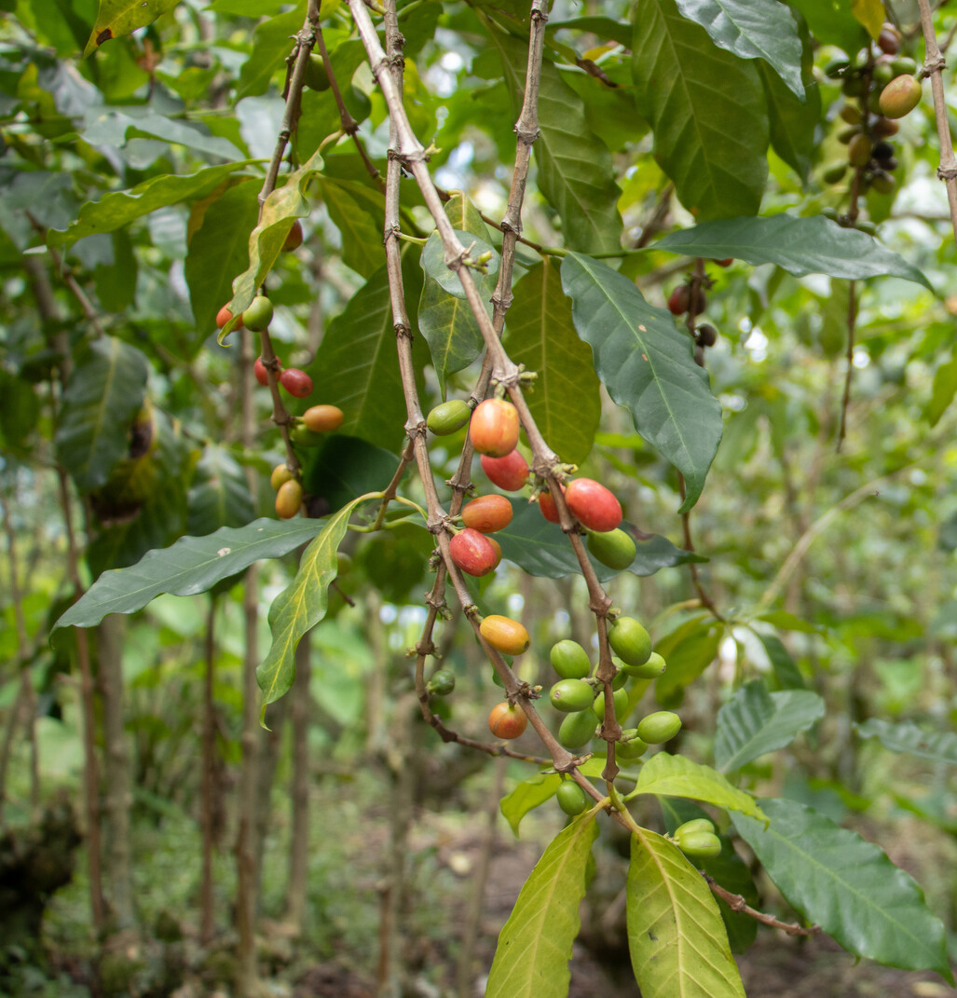

The Democratic Republic of Congo (DRC) has vast amounts of natural resources.
Over centuries these resources have been exploited by wealthier countries.
It’s likely your
mobile phone includes materials from the DRC.
Coffee beans growing in the DRC

Slide 3

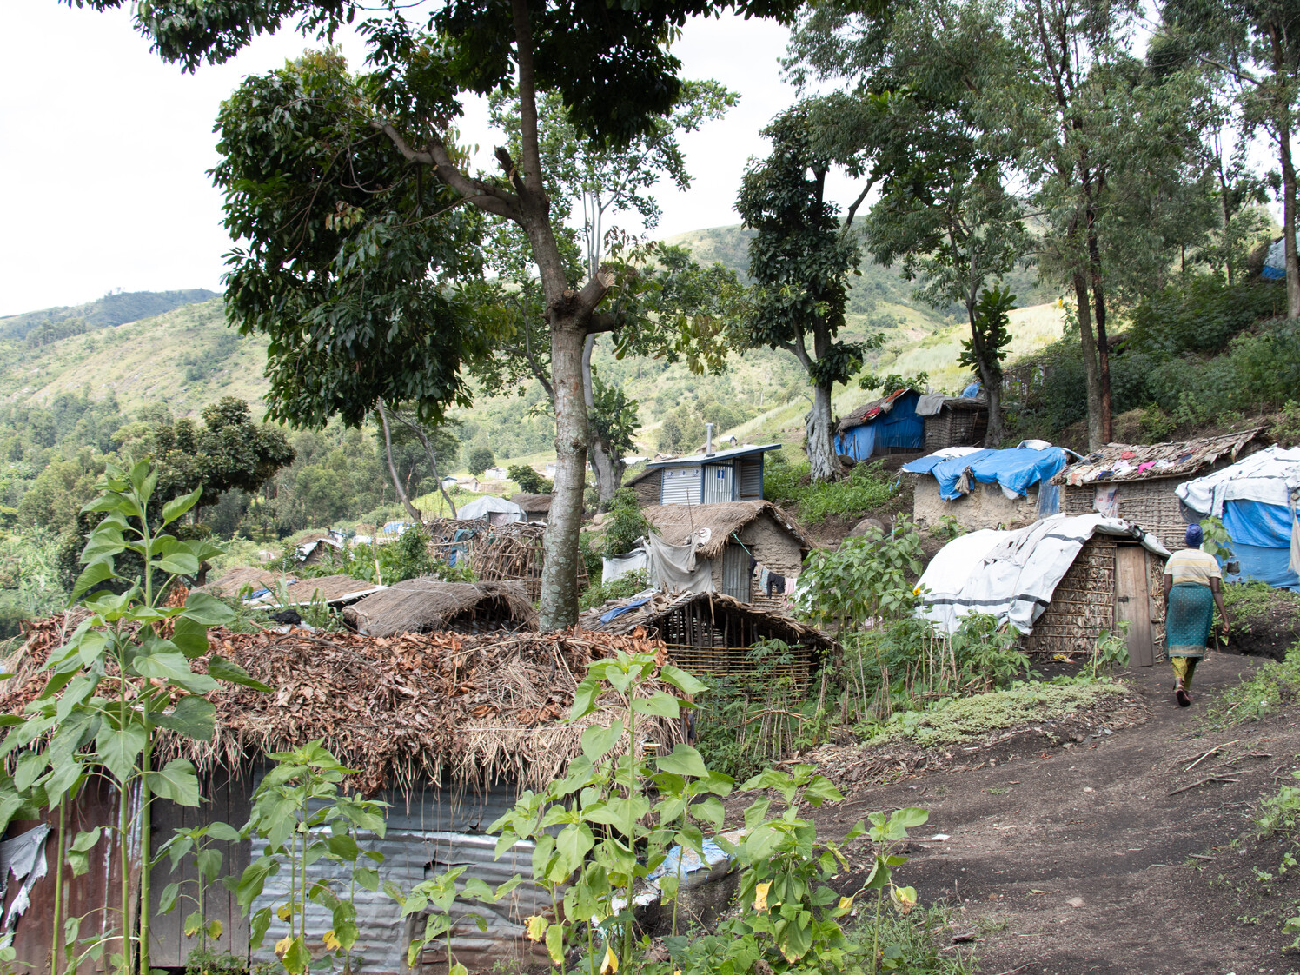

Exploitation and conflict mean millions of people in the DRC
live in extreme poverty. 70% of people lived on £1.50
a day or less in 2024.
A camp for displaced people in South Kivu in the DRC.

Slide 4
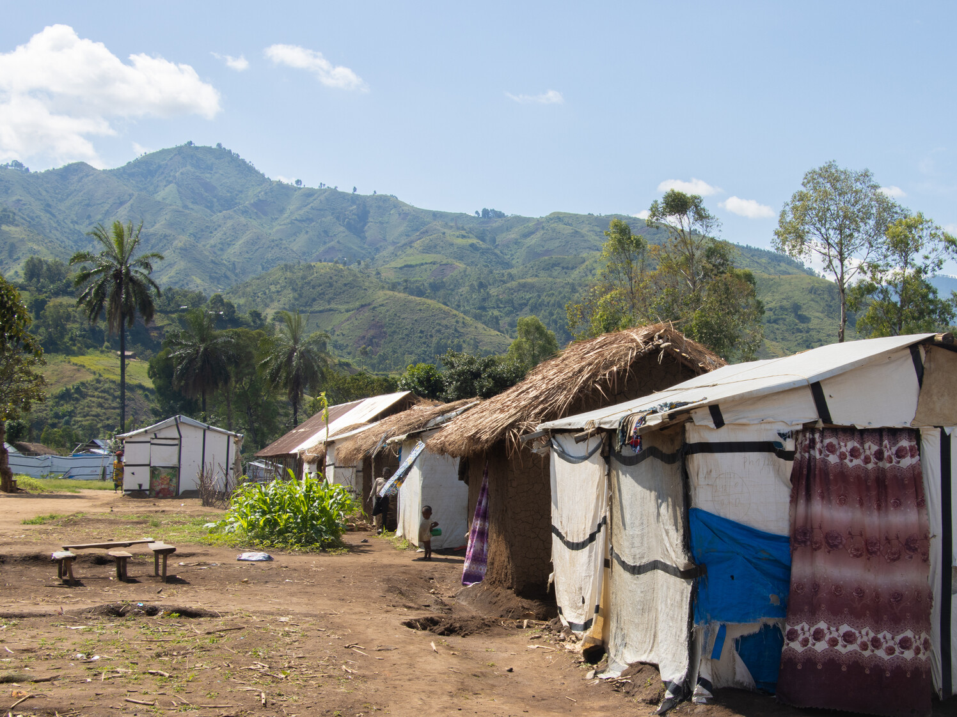

Katashola Camp for displaced people in the DRC.
Today the DRC faces one of the largest humanitarian crises of our time.
Conflict between armed groups and government forces is forcing families to flee their homes.

Slide 5
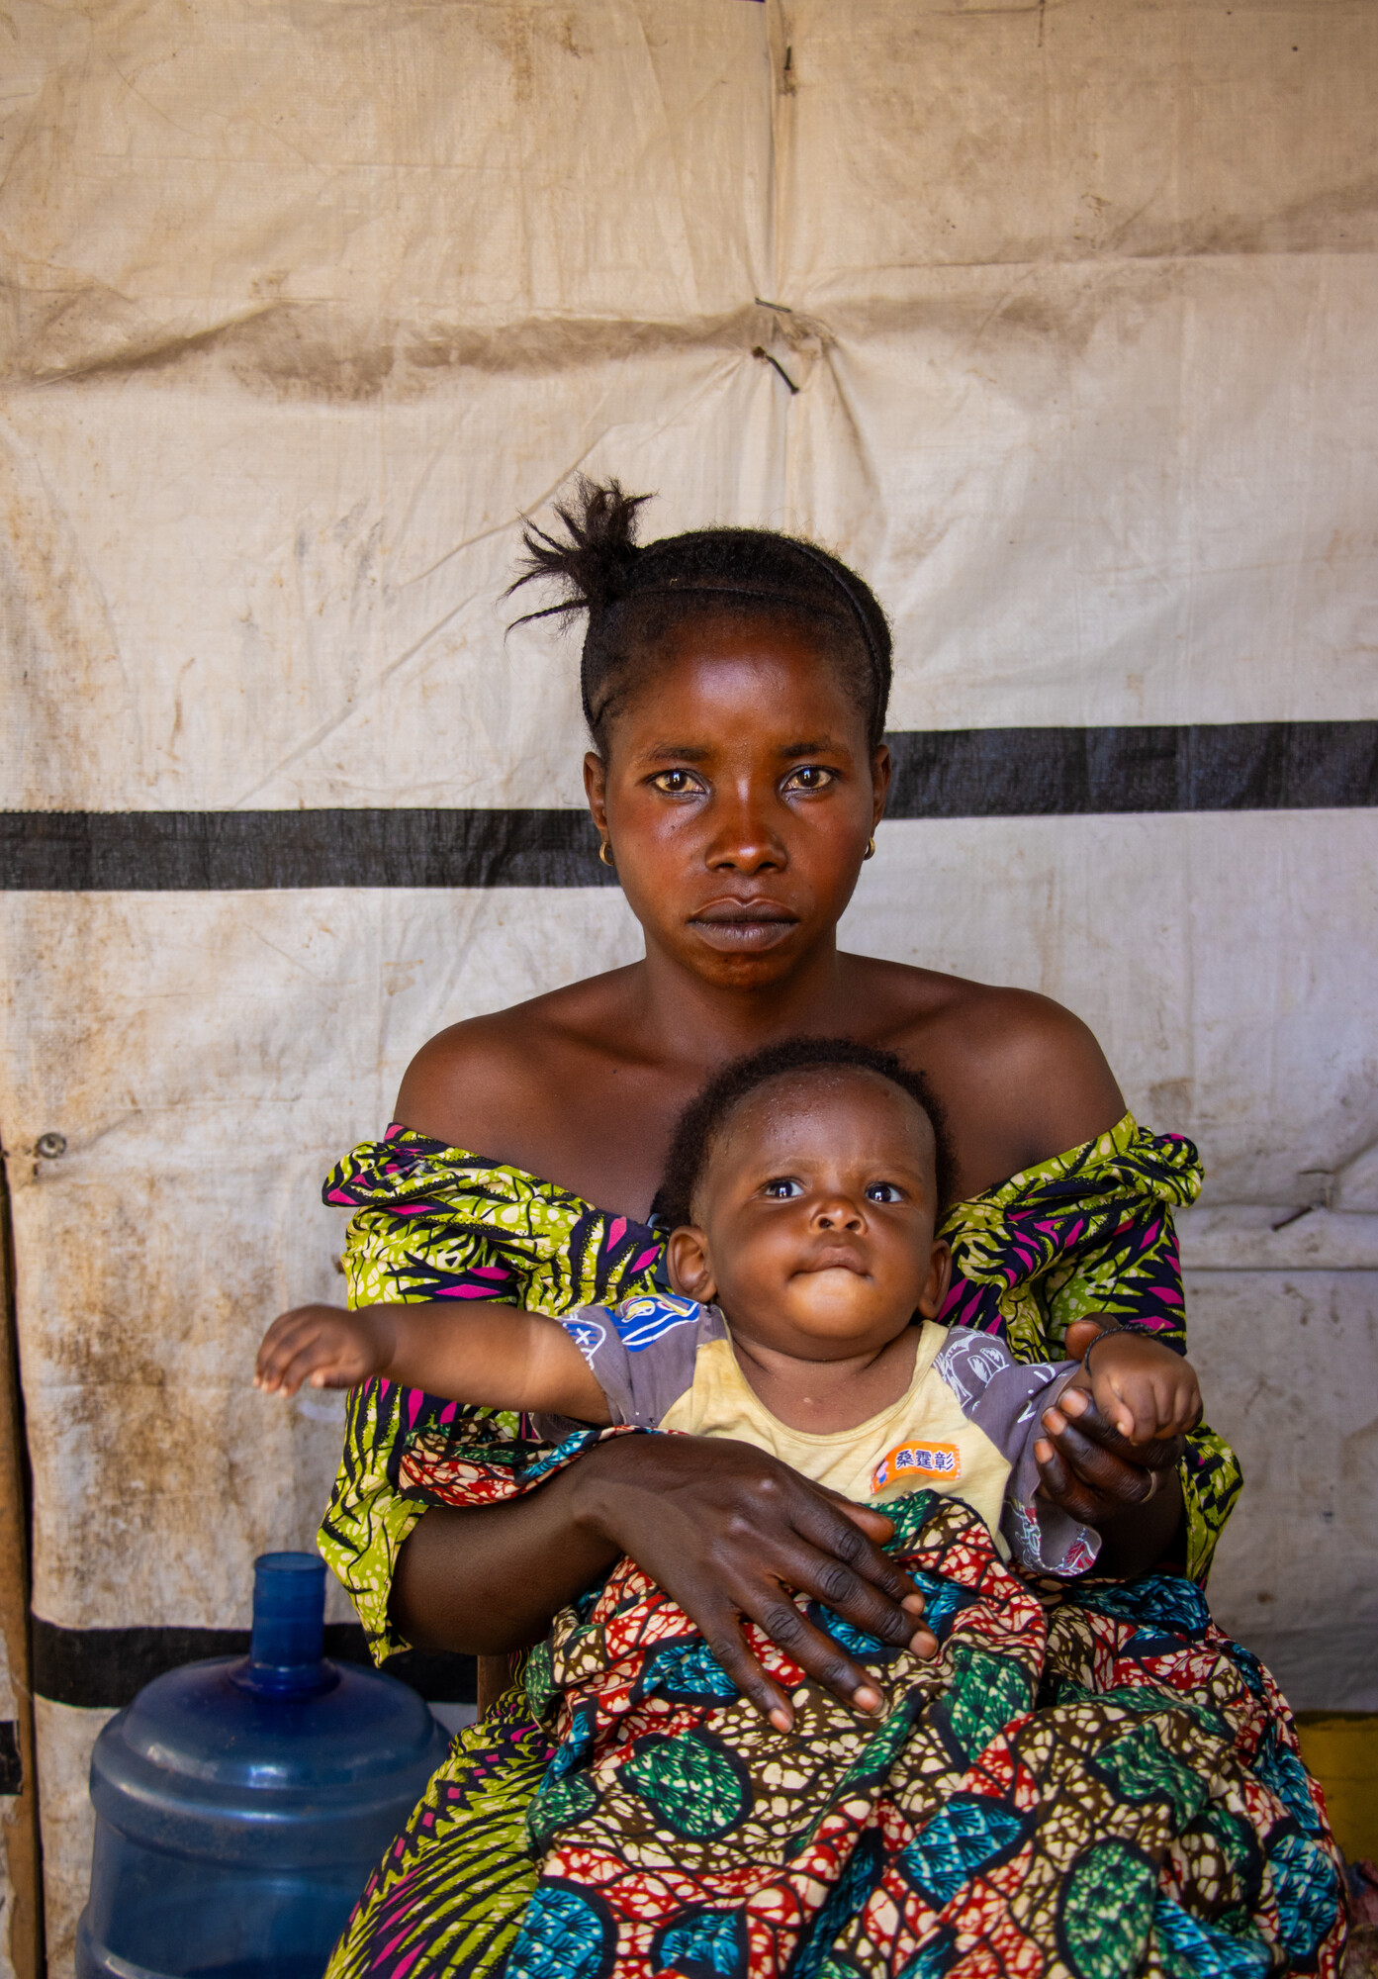
Chance has eight children, including baby Siborge. She was forced to run from her home to escape armed conflict, shortly after giving birth. She was separated from her husband and does not know where he is.
Chance with baby Siborge in Katashola camp.

Slide 6
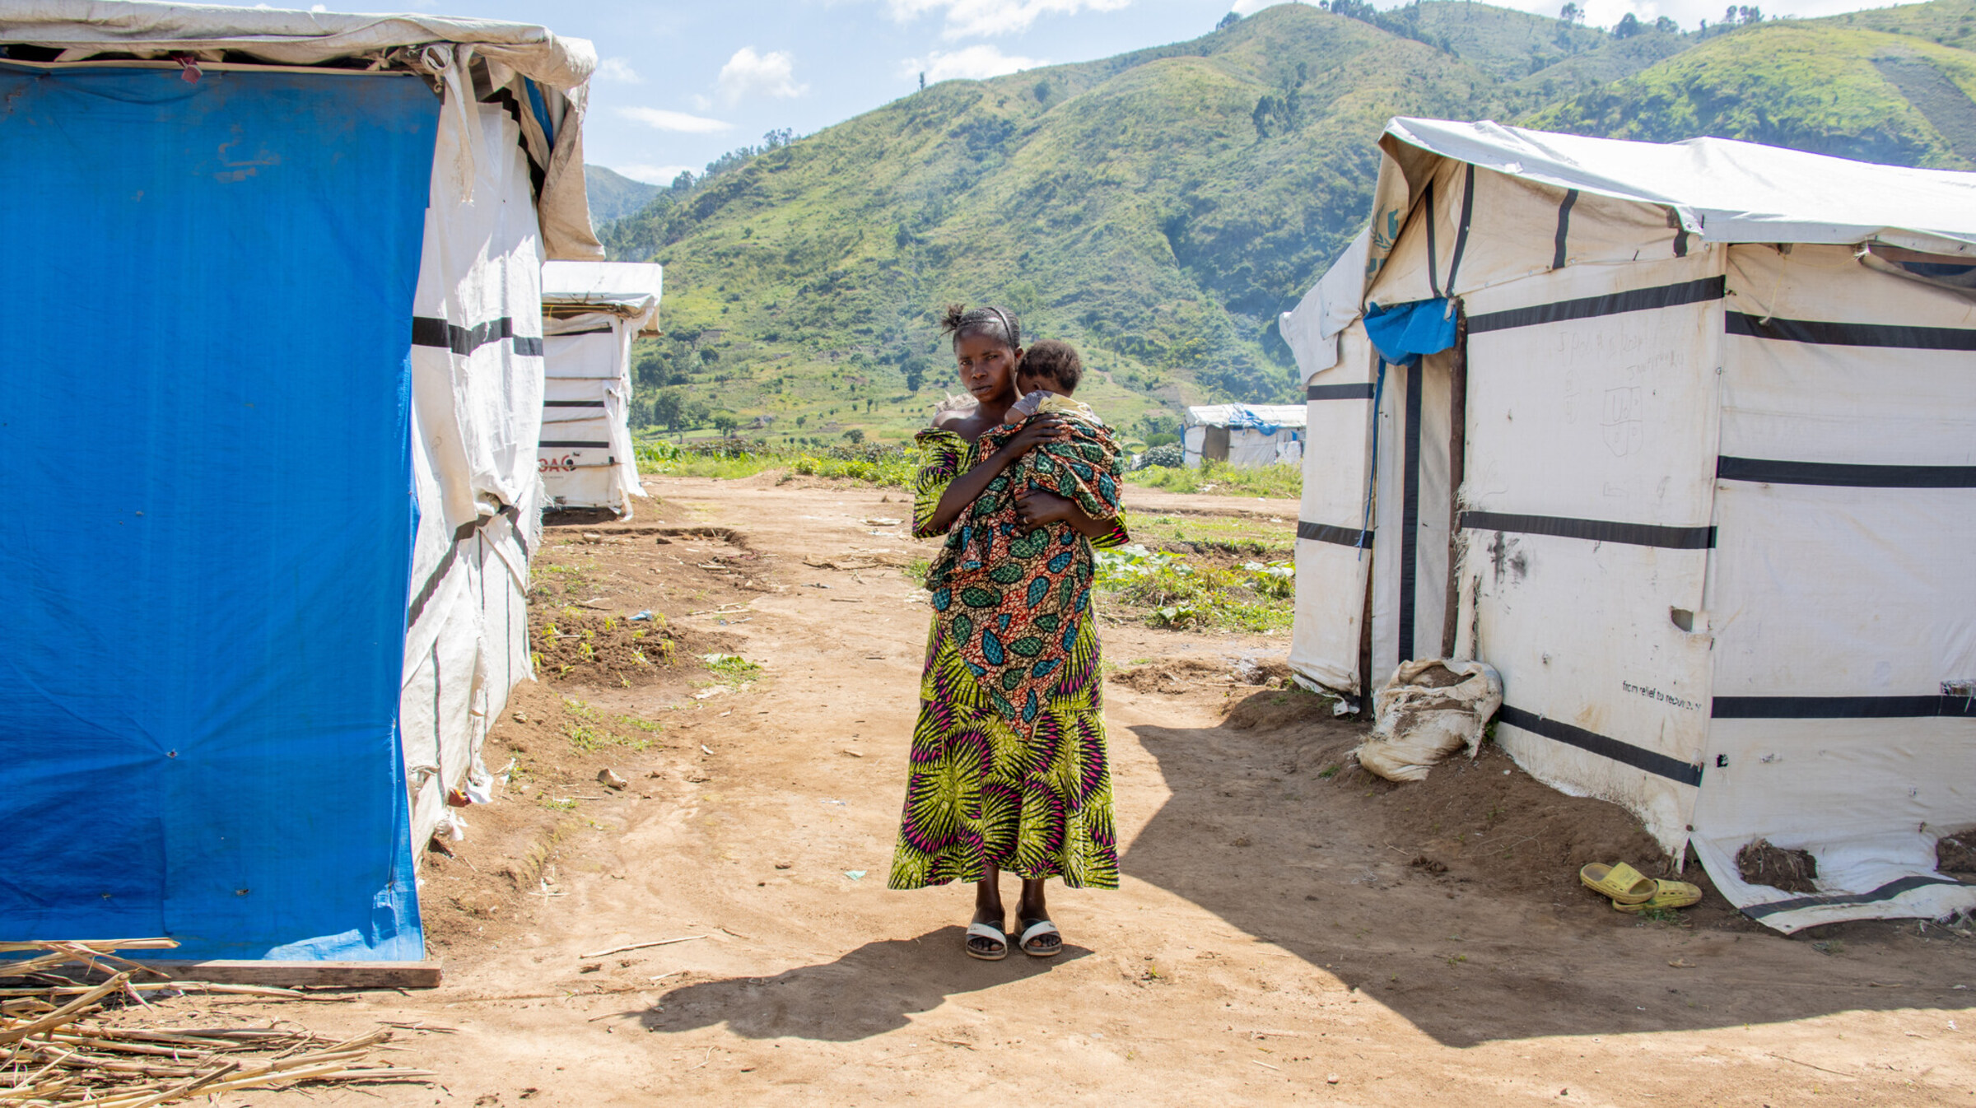
Here in the camp, people need food, clothes … we have nothing like blankets and mattresses. The life I am living with this baby is very painful. Even finding soap to wash him and his clothes is so difficult.
- Chance
Chance reached the relative safety of Katashola camp for displaced people. But Chance and her children don’t have the essentials they need and are at risk of malnutrition.

Slide 7



Working with our trusted partners ECC-MERU, Christian Aid offers financial assistance to displaced people like Chance and her children. Cash grants enable parents to buy food, bedding and blankets for their children.

Slide 8
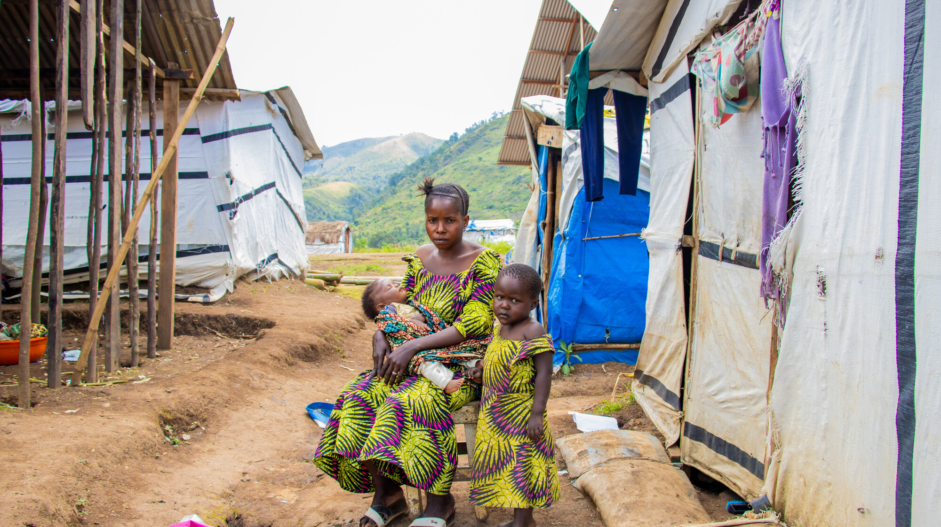



This Christmas families who’ve escaped conflict urgently need your support to survive.
Please join us in praying, acting
and fundraising.

Slide 9

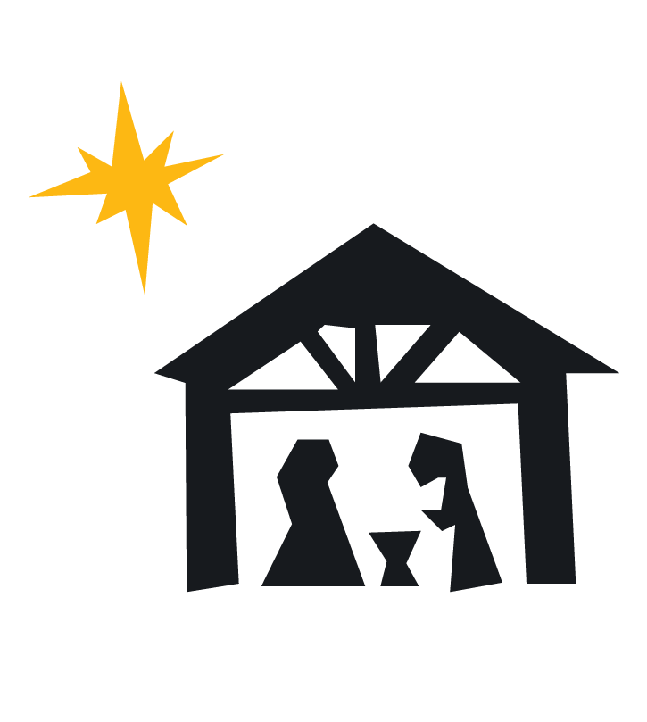
A Prayer for Displaced Peoples
Prince of Peace,
As an infant you had no safe place to rest.
We pray to you today for all children
forced to flee violence in the Democratic
Republic of Congo, in Gaza and in many
other places across your world.
We lift to you families and communities
enduring instability and fear.
In this season of hopeful expectation, we
pray for those who do not know what
tomorrow will bring.
Challenge us, Lord, to live out your call to
seek peace and pursue it.
Heal our divisions and inspire us to act
with justice and love.
In your holy name we pray, amen.

Slide 10


