Slide 1

Christian Aid Week 2026
Faithful action

Slide 2
This presentation is designed for churches and groups holding a service for ​Christian Aid Week 2026.​
You can find our accompanying Order of Service outline and download our Christian Aid Week film at:
caweek.org/Worship​
Notes:
You’re welcome to adapt this presentation to reflect the pattern of your service. At certain points you can choose between different options (for example, readings and prayers of intercession). You will see that all options are included in these slides.

Slide 3
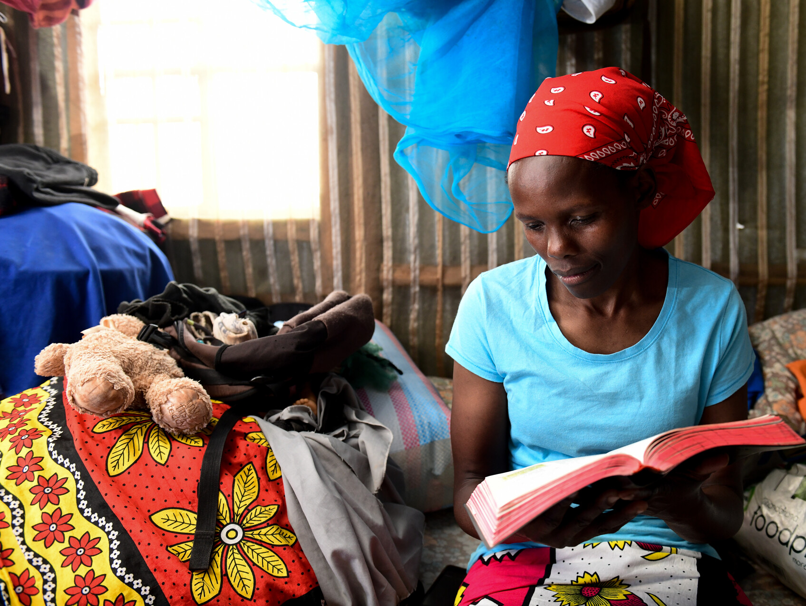


'The one who calls you is faithful.'
Select ‘picture fill’ to add image into this shape
(1 Thessalonians 5:24)
Belinda Kasudi reading the Bible in her one-room home in Dagoretti, Nairobi.
Notes:
The theme of today’s service is ‘faithful action’. Scripture tells us: ‘The one who calls you is faithful’ (1 Thessalonians 5:24). God’s boundless love and care for us is offered to us at every moment.
We are called to reflect the faithful and compassionate nature of God in our own words and actions.
All photos in this presentation belong to David Macharia and Christian Aid.

Slide 4
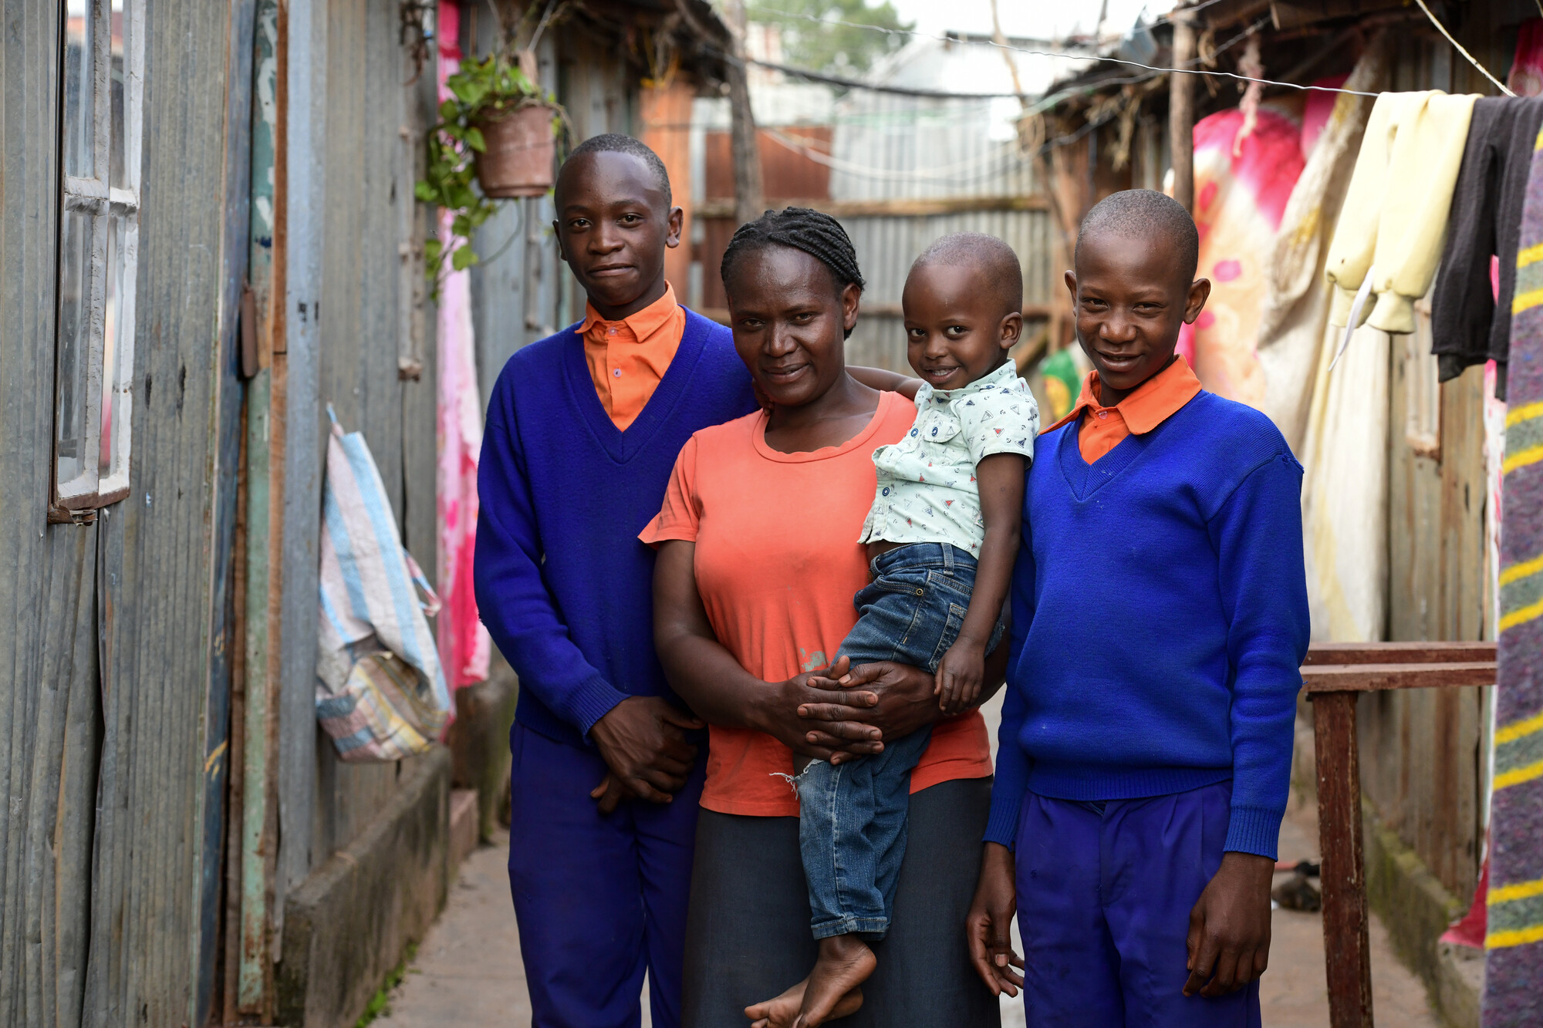
Fridah Moraa with her twin sons Abiud and Eliud and her grandson Quillan in Dagoretti, Nairobi.
Notes:
We will hear from two courageous women: Fridah Moraa and Belinda Kasudi. [See next slide for picture of Belinda and her family].
Fridah and Belinda are urban farmers in the informal settlement of Dagoretti in Nairobi, Kenya. Life here is precarious. Access to necessities such as running water and sanitation is limited. Parents wake up each day knowing that if they don’t earn enough, their children won’t eat that evening.

Slide 5
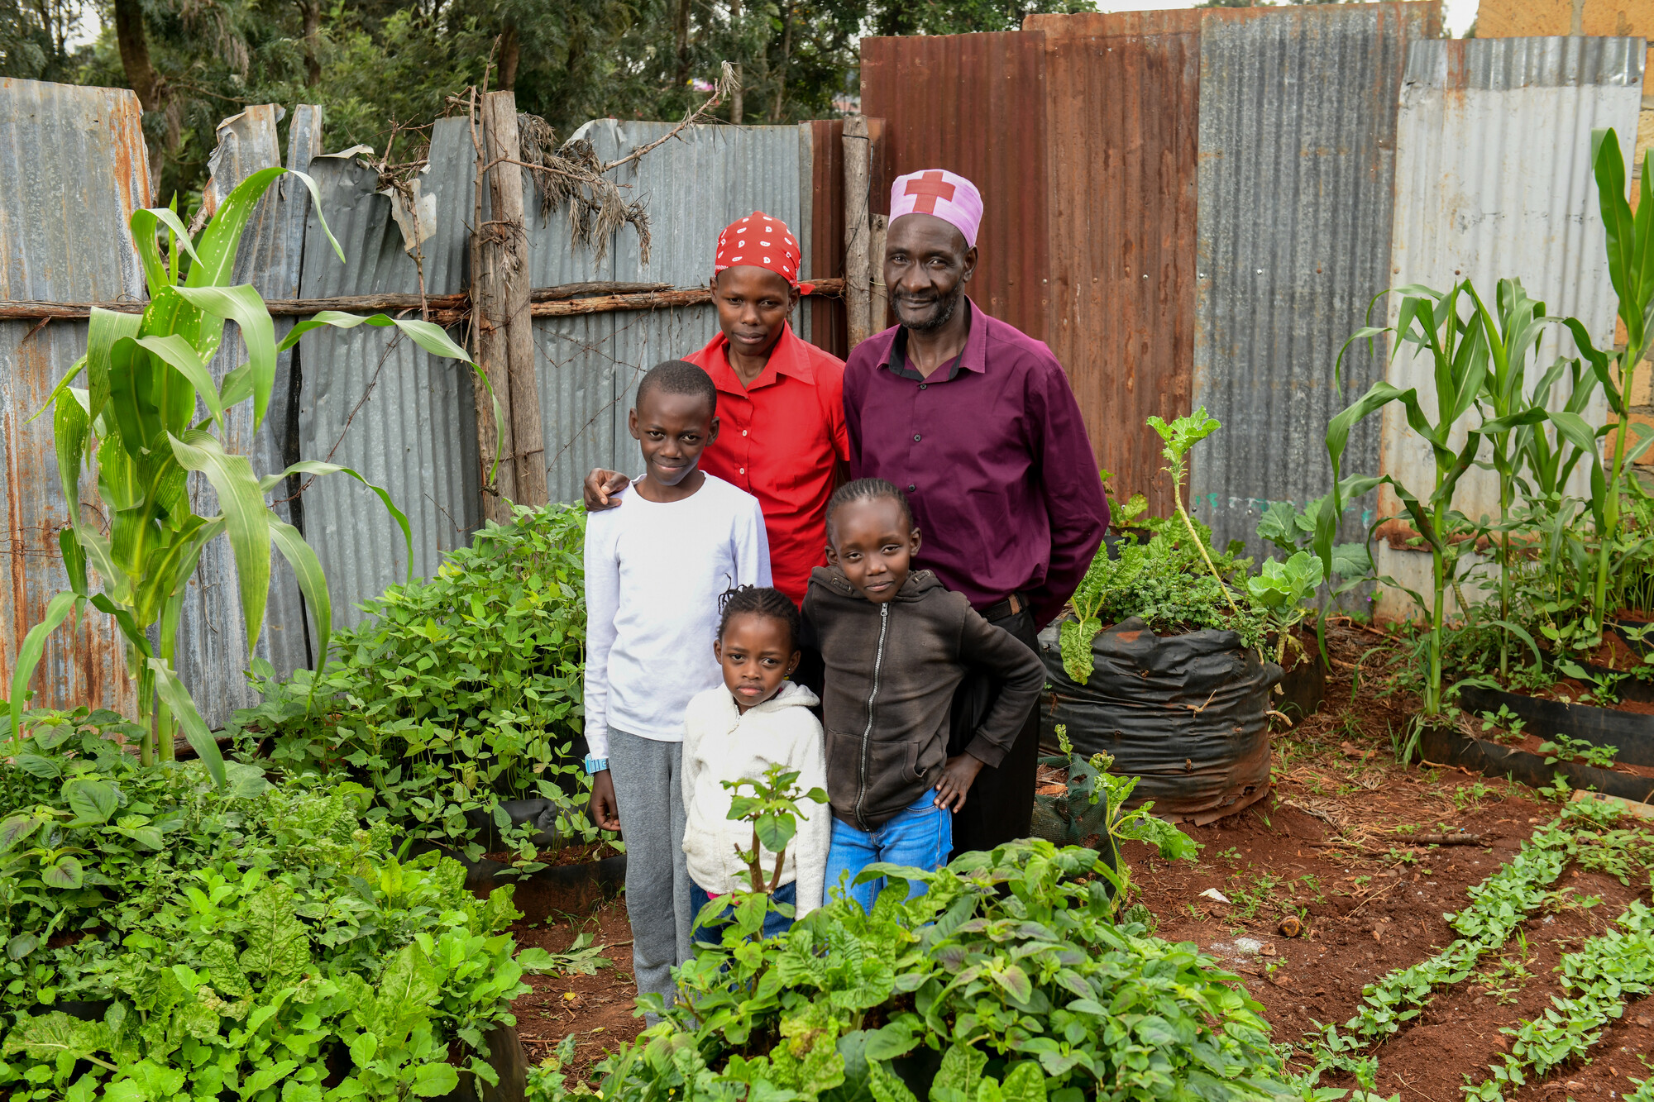
Belinda with her husband David and their youngest children, Wilson, Blessing and Abigail.

Slide 6

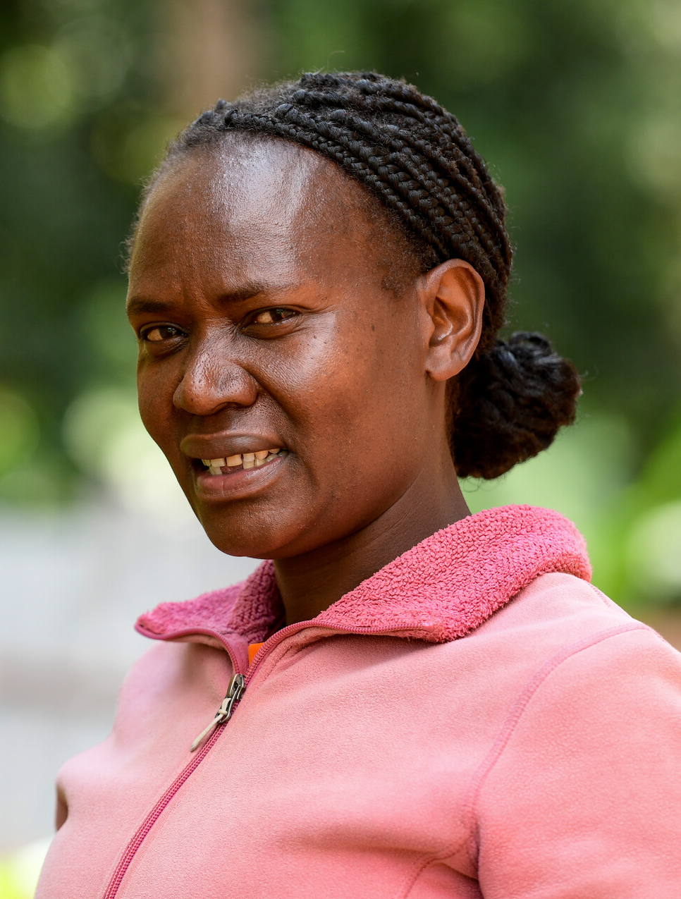
‘It’s hard, but in God I trust – for the strength to keep going
every day.’
Fridah
Notes:
But mothers like Fridah and Belinda are determined to change their lives and those of their children
They have seized the opportunity to grow vegetables in the smallest and most unlikely spaces, providing nutrition, income and opportunity for their families. As Fridah tells us: ‘It’s hard, but in God I trust – for the strength to keep going
every day.’

Slide 7

Call to worship
Creator of all,
you are faithful to the world you have made.
I will praise you Lord, with all my heart.
Giver of abundant life, you long for our flourishing.
I will praise you Lord, with all my heart.
Good Shepherd of the sheep, you know us and love us.
I will praise you Lord, with all my heart.
Lord, as we gather in prayer and praise, we ask that you renew our faith,
and form us into one body, ready to serve you.
Amen.

Slide 8
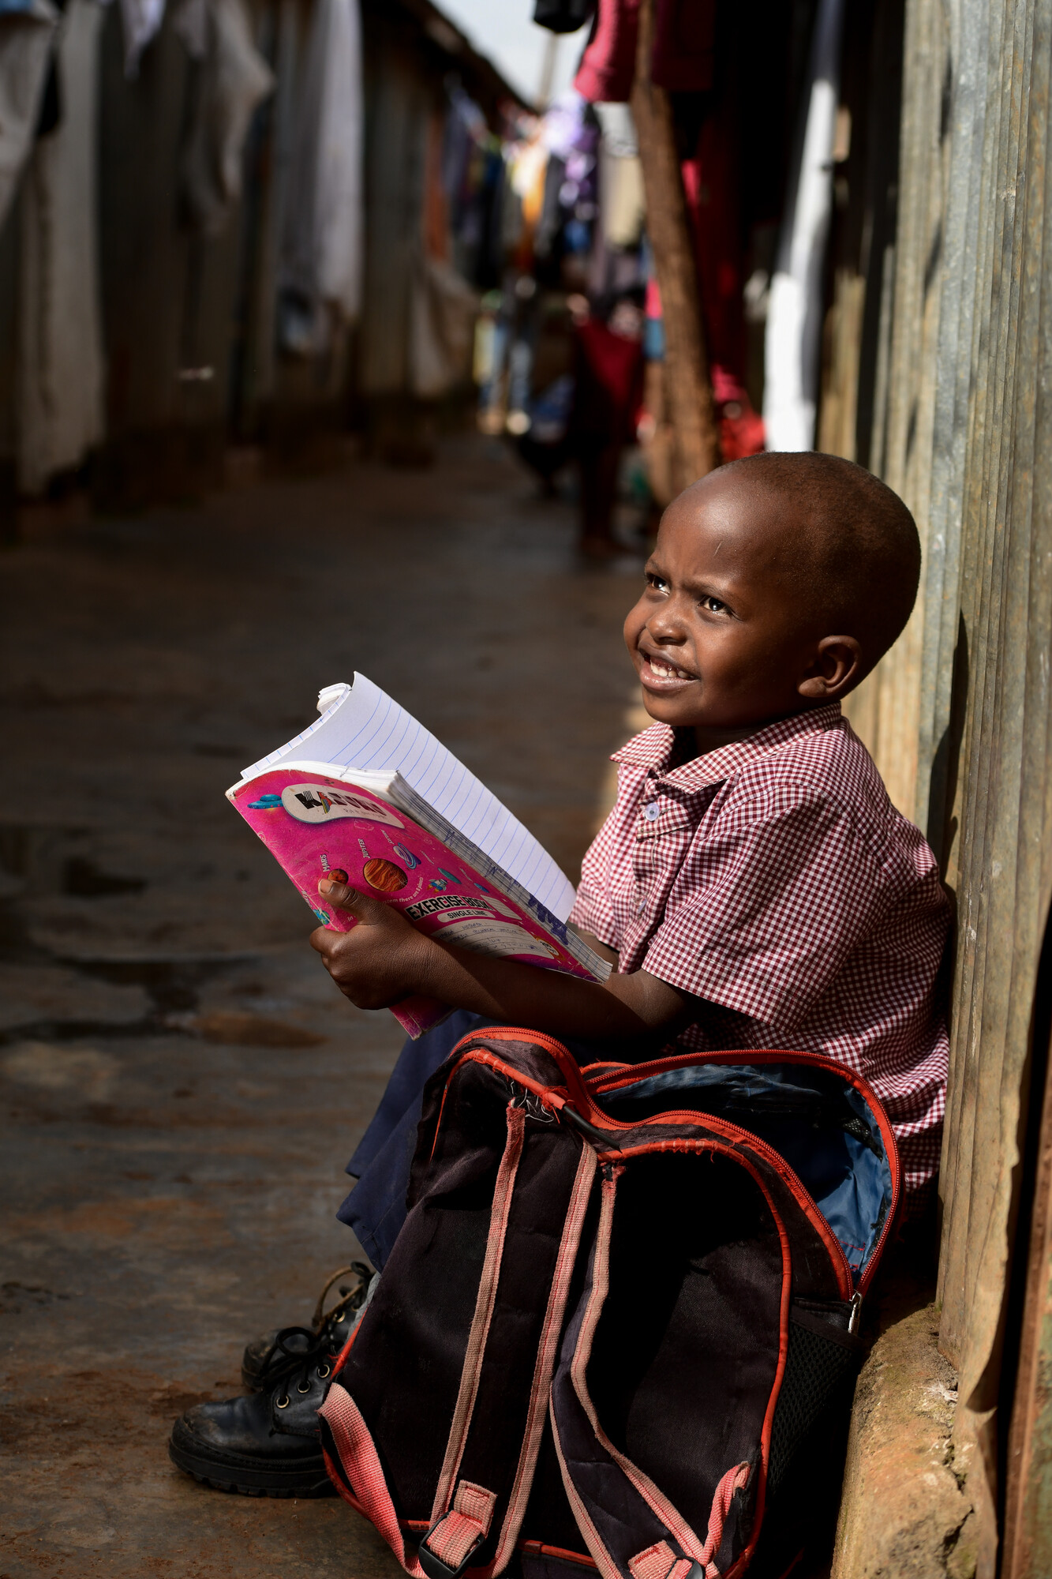
Fridah’s four-year-old grandson Quillan with his schoolwork in the street in Dagoretti.
‘I can’t give up,’ Fridah says, ‘my children need to go to school. They need to eat.’
Notes:
Fridah Moraa lives in the informal settlement of Dagoretti in Nairobi, Kenya. She rents a corrugated metal shelter to house her children and grandson. They do not have running water inside their home and share a basic toilet with several other families. Fridah recently lost her husband in a tragic accident and feels his loss acutely. 'He's left a big gap,' she says.'
Day-to-day life for Fridah can be precarious. She wakes every morning worrying about how to feed her family. ‘But I can’t give up,’ Fridah says, ‘my children need to go to school. They need to eat.’
Fridah has been trying to develop a stable income by selling vegetables, making a two-hour round trip to buy wholesale produce six days a week. Some days she doesn't sell enough of the wholesale produce at her market stall. On these days she goes without food, so the children can eat.

Slide 9

Opening prayer
Faithful God,
we come before you
with our gifts and strengths,
and with our faults and weaknesses,
knowing your unfailing love for us.
Open our hearts and our minds,
that we may hear your word and act on it.
Foster in us boldness and perseverance.
Transform us into your likeness,
and inspire us to build your kingdom of justice and love on earth.
Amen.

Slide 10
Prayer of confession
God of mercy and grace,
your steadfast love extends to the heavens,
your faithfulness to the clouds.
Yet still we turn away from you.
We give up in the face of challenges.
We allow division to deepen.
We tell ourselves that you have deserted us.
When we lose faith, loving God,
in your mercy:
Forgive us and help us.

Slide 11
Prayer of confession
Jesus, you call us to love one another
and share our good gifts with our neighbours.
But too often we say: ‘Am I my brother’s keeper?’
We hold tight to what is ours.
We do not listen to cries for justice.
We tell ourselves that there is nothing we can do.
When we fail to turn our faith into action, loving God,
in your mercy:
Forgive us and help us.

Slide 12
Prayer of confession
Holy Spirit, your fruit is faithfulness,
love, joy and peace.
Too often we fear the growth and change
that comes with being guided by you.
We would rather pursue our own way.
We do what is wrong
and we neglect to do what is good.
When we fall short as faithful followers, loving God,
in your mercy:
Forgive us and help us.

Slide 13
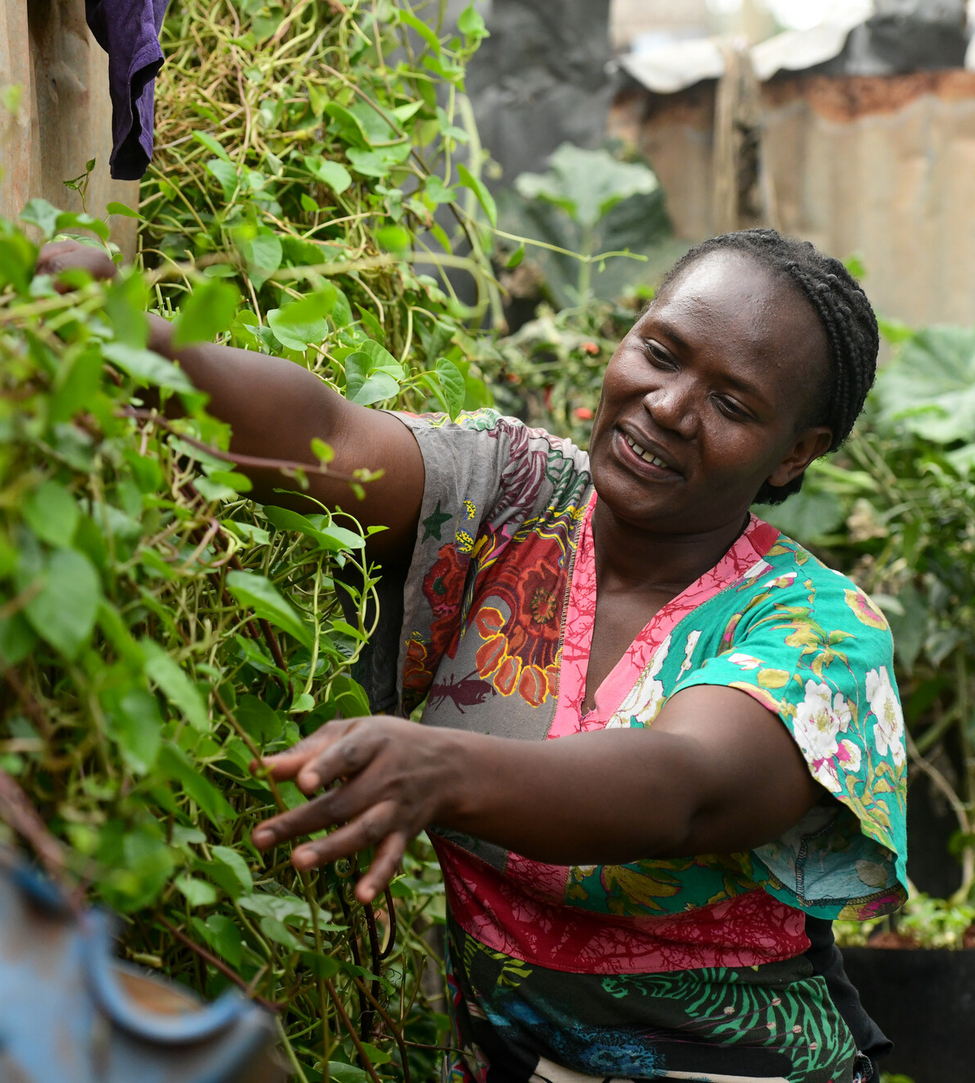
‘Now I can plan... I can help my family. Urban farming has changed
my life.' Fridah
Fridah tends her urban farm.
Notes:
Recently Fridah has seized the opportunity offered by a project called ‘Imarisha Kilimo’ – Swahili for ‘Strengthen Agriculture’. Run by Christian Aid’s partner Beacon of Hope, this project trains women like Fridah in urban farming.
Families learn how to grow vegetables in small spaces, using cone gardens, a form of vertical planting. They learn to conserve rainwater, make organic compost, and use dehydrators to preserve food.
Now, tucked at the end of a concrete alley, Fridah tends her lush urban farm, full of kale, tomatoes and other vegetables. Her children and grandson eat fresh vegetables, and she sells her produce at market.
For Fridah, this has been transformative. ‘Now I can plan... I can help my family. Urban farming has changed my life.'

Slide 14

A prayer for Christian Aid Week 2026
Gracious God,
when we stand on the plains of uncertainty,
with no path before us,
we look to you.
We remember what you have done before
and our anxious hearts are comforted.
Showing mercy, you delivered us then;
in your love and faithfulness, you will do it again.
Give us the strength to step forward in hope.
Give us faith that changes us, hope that feeds us, love that moves us.
In Jesus’ name,
Amen.

Slide 15

First reading [select one]
Acts 17:22-31 Isaiah 61:1-4,8
Acts 1:6-14 Psalm 23:1-6
Select ‘picture fill’ to add image into this shape
Notes:
Choose a reading for your service and amend the slide.

Slide 16
Christian Aid Week Film
Notes:
You can download the Christian Aid Week film ahead of your service at caw.org.uk/Worship or caw.org.uk/Resources

Slide 17
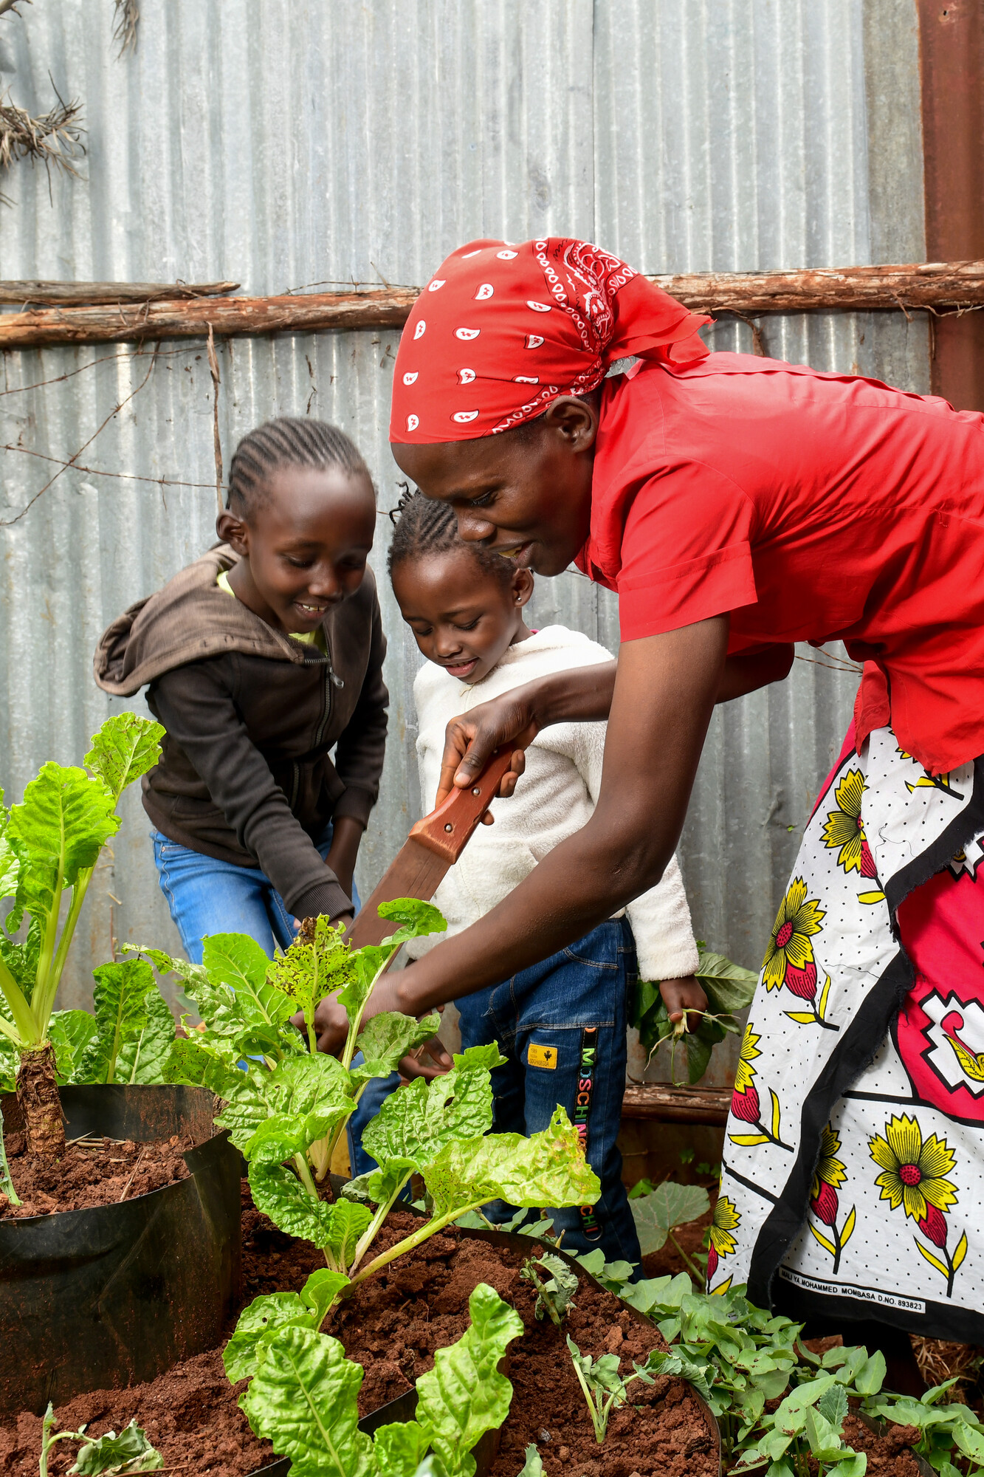
Belinda with her daughters Blessing and Abigail on their urban farm.
‘I am a woman who is happy, because I know that my family eats the food that I love to grow.’ Belinda
Notes:
Belinda Kasudi lives with her husband David and their five children in a wooden one-bedroom home in Dagoretti, Nairobi. David works for a building company, but his shifts are irregular. Some days there is no work – and no pay. Belinda picks up whatever jobs she can find, such as taking in laundry for neighbours. A stable income is vital for Belinda’s family. As
she tells us: ‘Everything here has to be paid for. We even buy water… Providing enough food for the children is very difficult, because it’s so tough to find a job.’
Belinda loves learning and is excited to be part of the Imarisha Kilimo project. She has been able to create her own water-saving cone garden, growing spinach, beetroot and local specialities such as managu.
Belinda delights in being able to feed her children fresh ingredients, and in selling any extra vegetables to help with costs like school supplies.
As she joyfully explains: ‘I am a woman who is happy, because I know that my family eats the food that I love to grow.’

Slide 18
Second reading [select one]
John 14:15-21 Luke 13:18-20
John 17:1-11 Matthew 7:7-11
Select ‘picture fill’ to add image into this shape
Notes:
Choose a reading for your service and amend the slide.

Slide 19
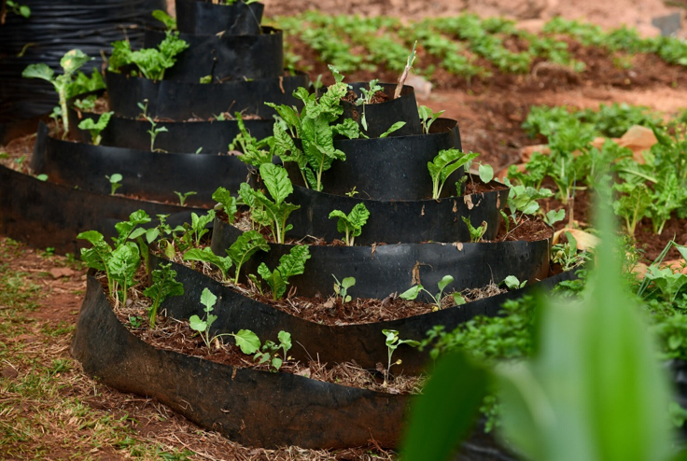
Sermon
A water-saving cone garden at the offices of Beacon of Hope, Dagoretti, Nairobi.

Slide 20
Prayers of intercession [option 1]
The response is:
Lord, you are faithful and just.
In your mercy,
hear our prayer.
The final response is:
Great is your faithfulness, Lord.
You have promised to hear us when we call upon you.
Receive these prayers, in Jesus’ name.
Amen.
Select ‘picture fill’ to add image into this shape
Notes:
There are three choices for prayers of intercession. Look through our Order of Service and choose one. You can download everything you need at caw.org.uk/Worship

Slide 21
Prayers of intercession [option 2]
• Communities in Kenya who are living in informal settlements.
• Urban farmers growing crops in unlikely places.
• Christian Aid’s partner in Nairobi, Beacon of Hope.
• Parents who are worried today about what their children will eat tomorrow.
• Communities living in overcrowded or inadequate housing.
• Communities who don't have reliable access to clean water and sanitation.
Select ‘picture fill’ to add image into this shape

Slide 22

Prayers of intercession [option 2]
• Action on the debt crisis, driven by unscrupulous private lenders, that is unjustly impacting countries like Kenya.
• Governments and those with power.
• The work of Christian Aid, and all who support this work by giving, acting and praying together.
Select ‘picture fill’ to add image into this shape

Slide 23
Meditative prayer activity
Pass around a large stone.
Pray for all present. Ask that God will help them with whatever
worries they hold.
Pray for Fridah, Belinda and other families in Dagoretti and for all
they are carrying.
Pass around a bowl of small seeds. Take some in your hand.
Pray for the change these seeds represent.
Pray for transformation in the lives of those present and change
for our global neighbours, wherever it is needed.
Select ‘picture fill’ to add image into this shape
Listen to the Kenyan folk hymn
Wana Baraka.
Notes:
This meditative prayer activity works well with small groups. Find full details in our Order of Service outline. Recordings of the hymn Wana Baraka can be found online in a number of different places.

Slide 24

The Lord’s Prayer
The Peace
'For the mountains may depart
and the hills be removed,
but my steadfast love shall not depart from you,
and my covenant of peace shall not be removed,'
says the Lord, who has compassion on you.
(Isaiah 54:10)
The peace of the Lord be always with you.
Select ‘picture fill’ to add image into this shape

Slide 25
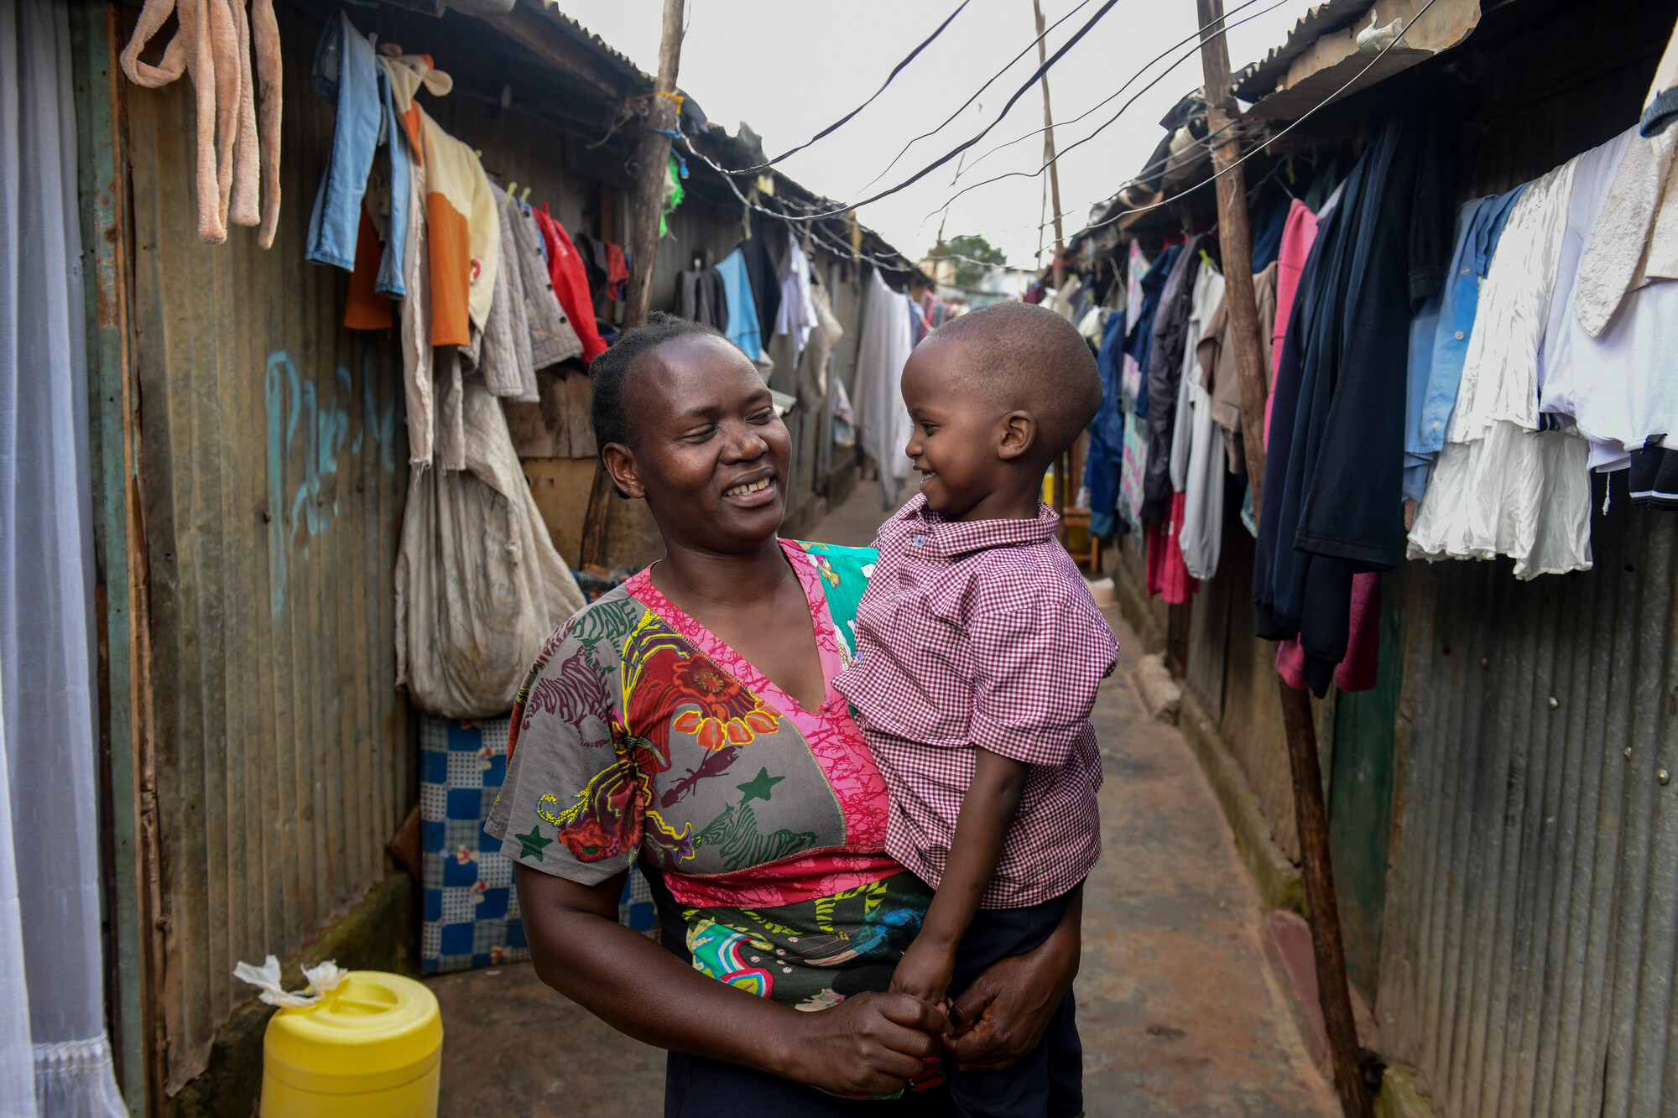
Fridah and Belinda are growing hope for their families.
Fridah with her grandson Quillan in the street near their home.
Notes:
Both Fridah and Belinda have spoken to us about their faith. Daily life remains tough for Fridah and her family: ‘But in God I trust,’ she says, ‘for the strength to keep going every day’. Belinda tells us: ‘When there is a challenge, most of the time, I pray.’
Fridah’s children are proud of their mum. Her 13-year-old son Abiud (Ab-ee-ud) declares: ‘My mum is very hardworking, patient and kind. The message that I can send to her [is]: thank you for taking care of me.’
In a place where hardship means hunger, Fridah and Belinda are growing hope for their families. They have put their faith into action. Fridah says the biggest difference is she can now make plans for her family’s future, rather than just surviving day by day. Belinda tells us she has become ‘an independent woman’.
For hard-pressed families in Dagoretti, ongoing support is vital to allow more urban farmers to access training and resources. This Christian Aid Week we have seven days to make a difference. How can we follow Fridah and Belinda and show our faith through our actions?

Slide 26
During this hymn/song, we’ll take a collection for Christian Aid
If you’d like to donate you can:
Use the red envelopes on your seat.
Donate online at caweek.org
If you can complete a Gift Aid declaration, your giving will go further.
Thank you for giving, acting and praying this Christian Aid Week.
Select ‘picture fill’ to add image into this shape
Notes:
You can amend this slide to include details of your own ways of collecting and fundraising.

Slide 27
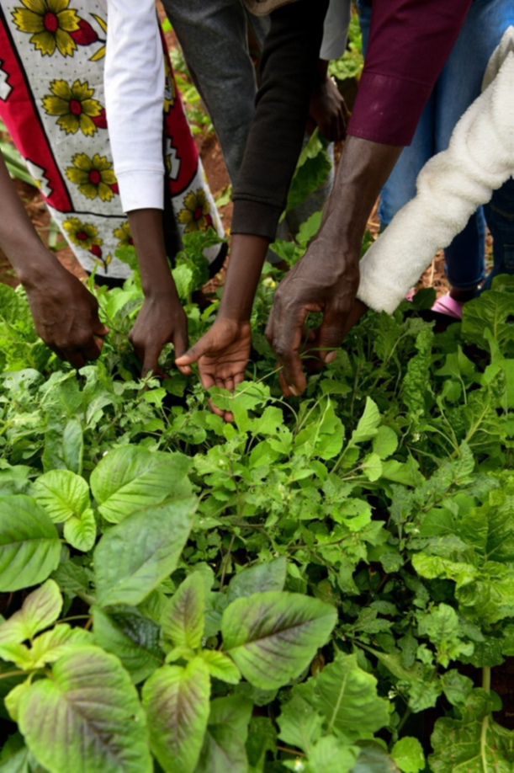
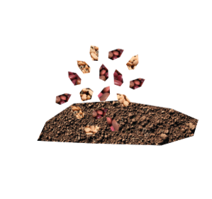
£5
could buy seeds to kickstart a family’s healthy vegetable garden.
Notes:
On the next few slides there are examples of the difference your fundraising can make. Why not share these with your church community?

Slide 28
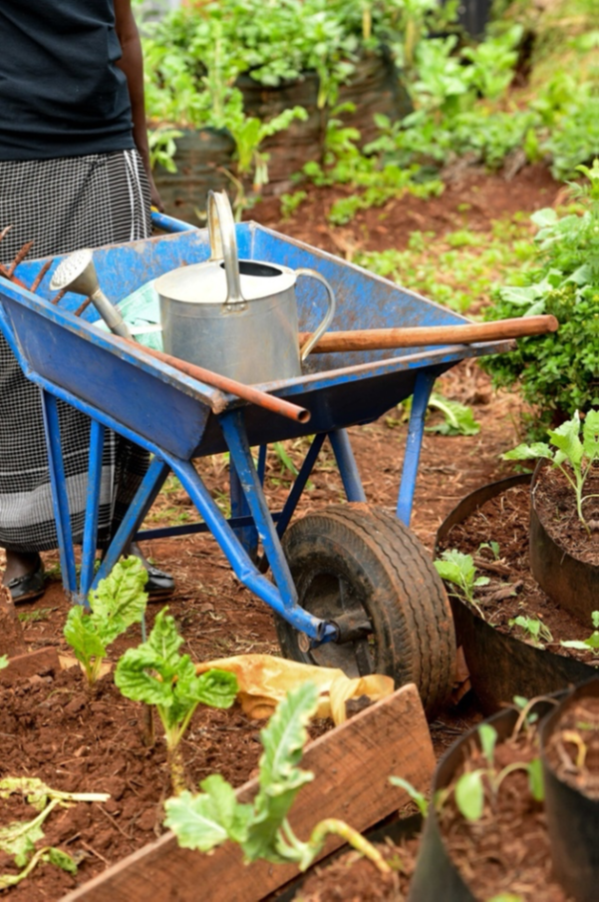

£15
could buy the hand tools for an urban farmer like Fridah to tend their crops.

Slide 29


£30
could buy a trio of cone garden planters to host dozens of plants in a tiny city space.

Slide 30
Prayer of thanksgiving
Almighty God, we love one another because you first loved us.
Send us out to act in loving service,
strengthened by the knowledge that the one who calls us is faithful.
We give thanks for the vital work of Christian Aid
and for all those who pour themselves out for the cause of justice.
May our actions and offerings plant seeds of change
that grow and flourish.
Guide us as we seek a world where every person can live a full life,
free from poverty.
Amen.
Select ‘picture fill’ to add image into this shape

Slide 31
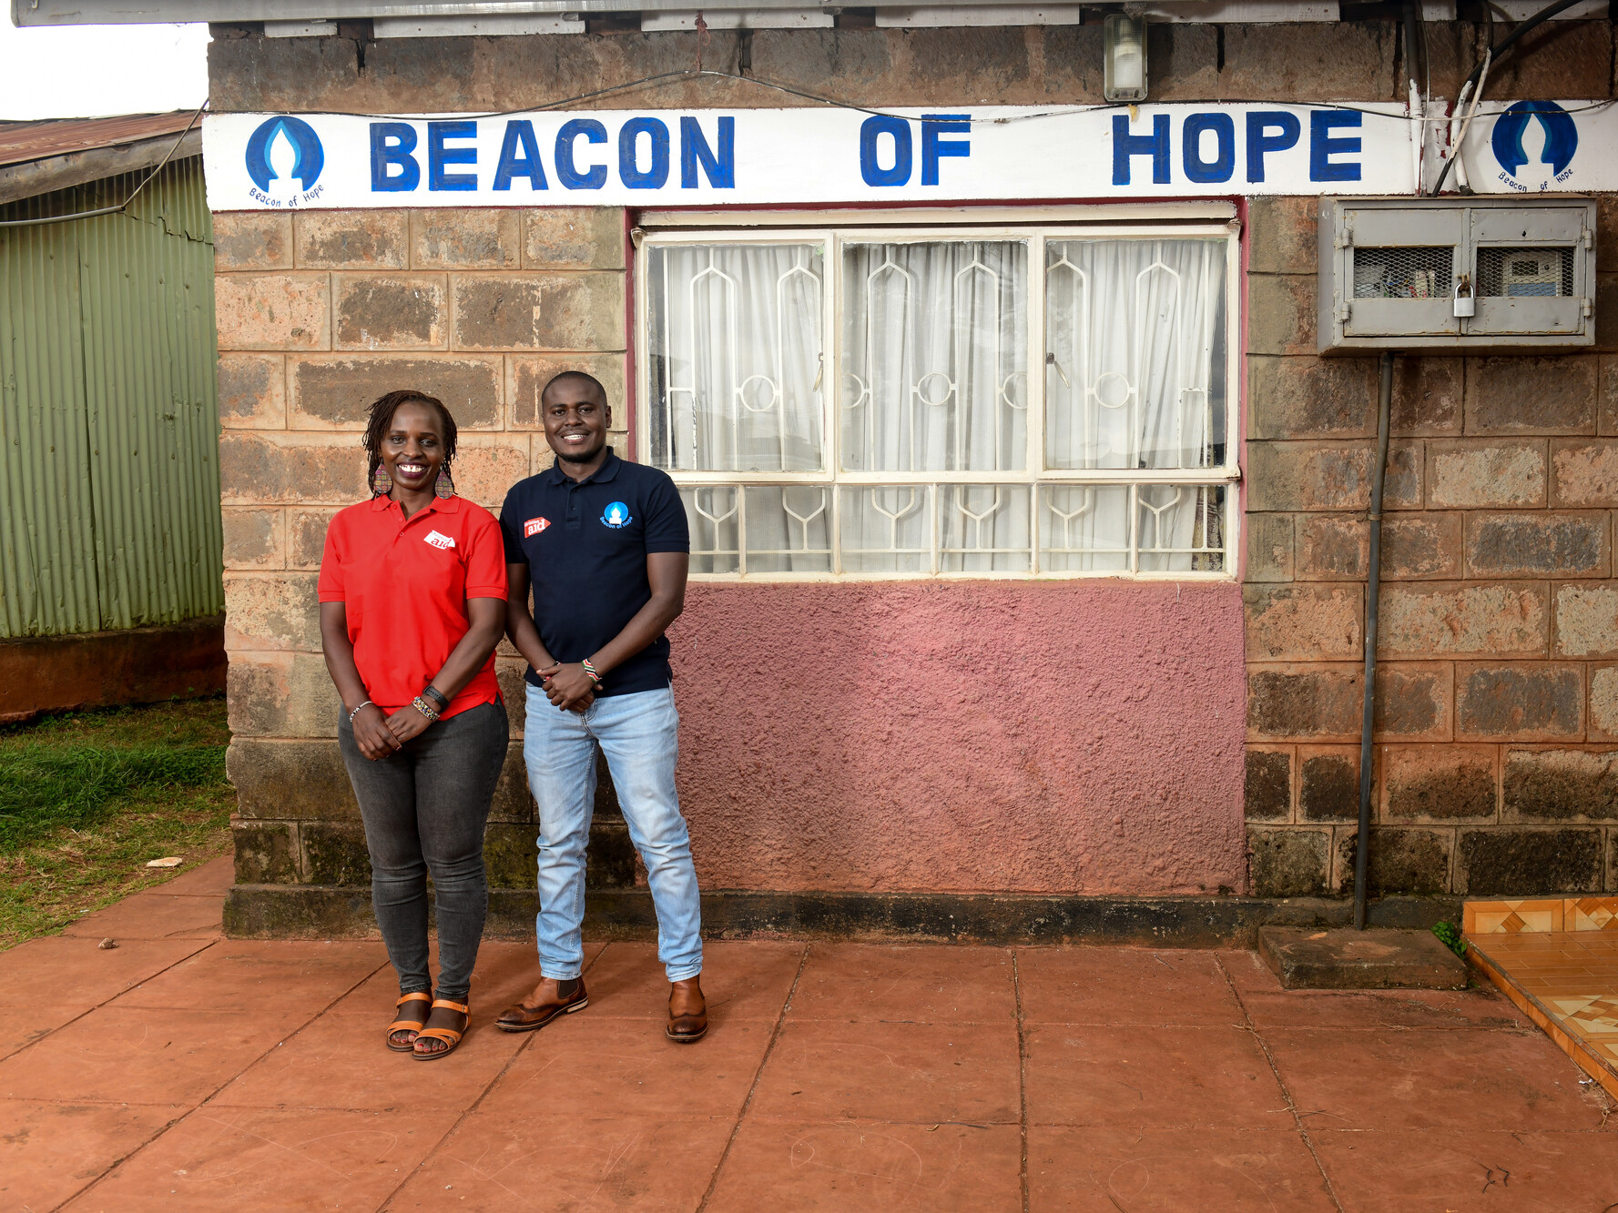
Blessing
May Jesus, who is the way,
guide you.
May Jesus, who is the truth
speak through you.
May Jesus, who is the life,
fill you with purpose.
And may God’s blessing go with you,
today and always.
Amen.
Purity Osumba from Christian Aid Kenya and James Omwanda from Beacon of Hope.

Slide 32
Thank you for your prayers and support this Christian Aid Week.
Christian Aid is a key member of ACT Alliance. Eng and Wales charity no. 1105851 Scot charity no. SC039150 Company no. 5171525 Christian Aid Ireland: NI charity no. NIC101631 Company no. NI059154 and ROI charity no. 20014162 Company no. 426928. The Christian Aid name and logo are trademarks of Christian Aid. © Christian Aid January 2026
Photos: slides 3-7: Christian Aid/Amaru P; Christian Aid/Omar Al-Qattaa; Oxfam/David Levene; Christian Aid/Jenny Tither; slides 8-28 Christian Aid/David Macharia.

